Slide 1
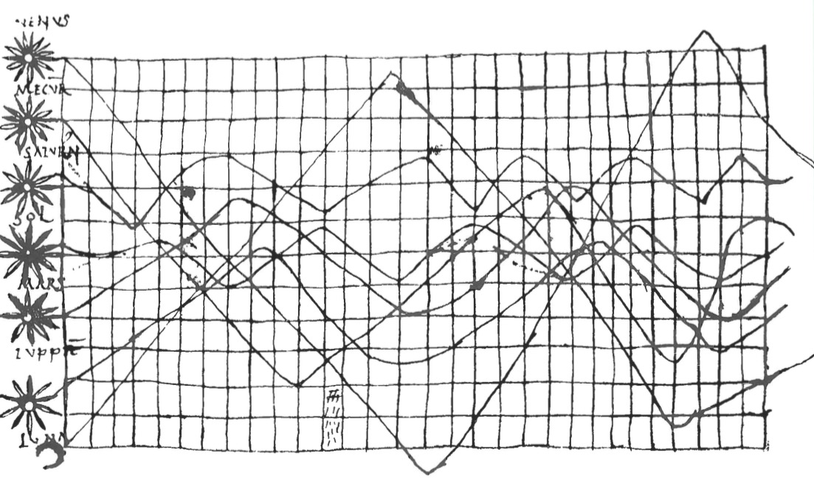
Data Visualization
Notes:
Reorganize – gets very choppy

Slide 2
Data visualization is Communication

Slide 3
Principles of Graphical Excellence
Clarity
Precision
Efficiency
Maximize ideas, minimize ink
(from Tufte)

Slide 4
Data Viz in a Nutshell
History
Graphical Basics
Details to Make Your Viz More Understandable

Slide 5
Data Viz in the 10th Century
From Funkhouser 1936
Notes:
10th century
What do you see here. What works. What does not?

Slide 6
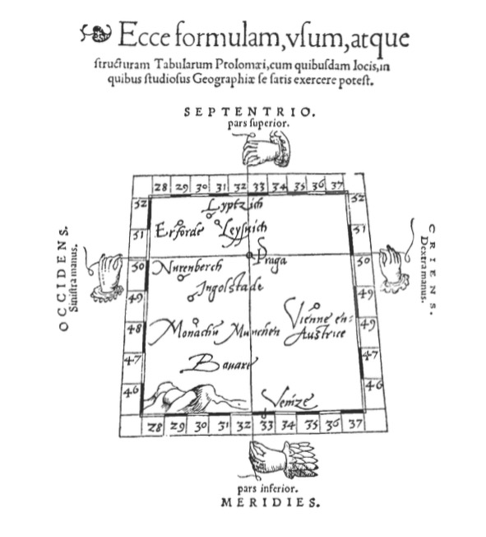
Notes:
Early maps. Little information beyond intersections – 1546 from Pedrus Apenius
What do you get from this?

Slide 7
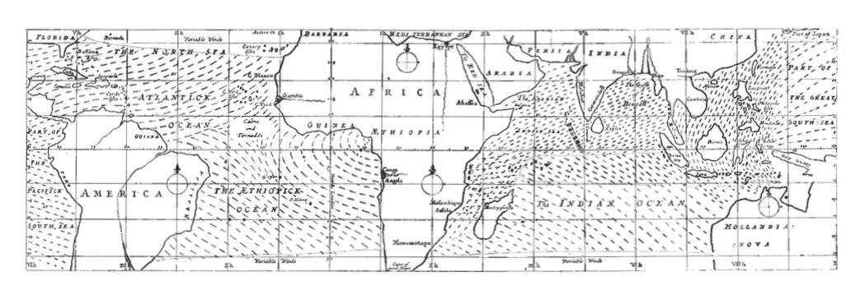
Maps as Rich Information Source
Notes:
Edmond Halley 1686

Slide 8
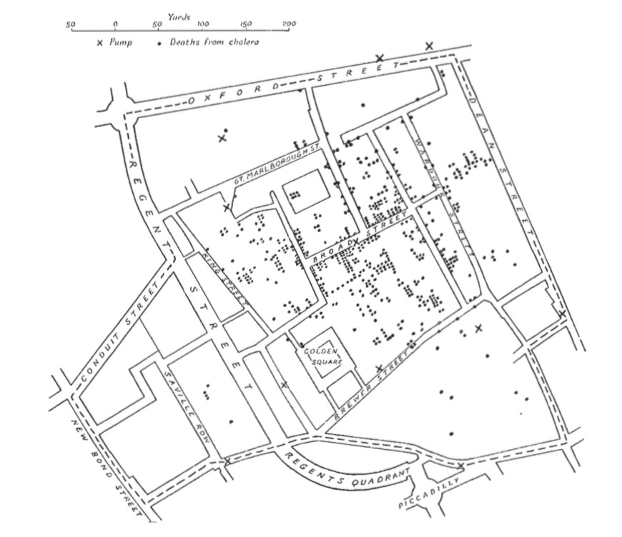
Spatial Patterns Intuitive
Notes:
How would you make this abstract?
John Snow 1854
It’s not all maps – timeseries, particularly as govs started getting into data

Slide 9
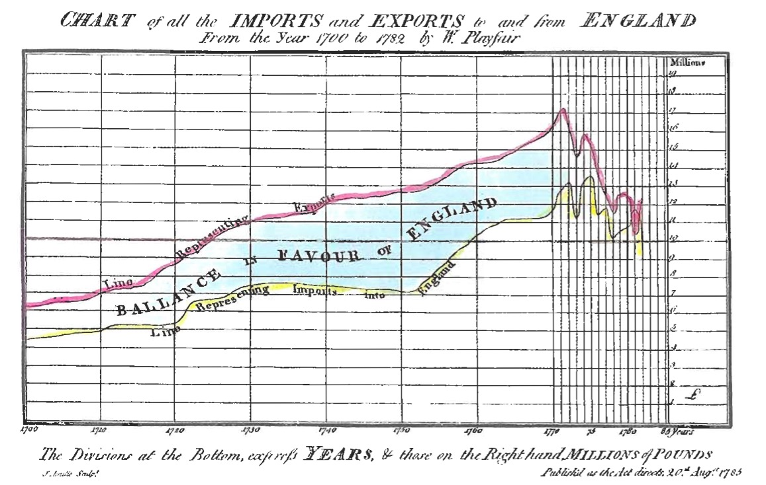
Notes:
Playfair! A father of modern statistical graphics

Slide 10
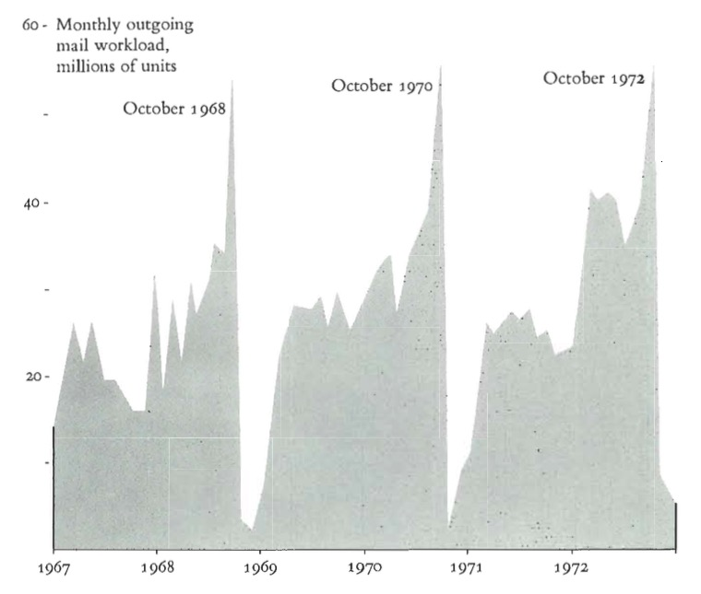
Sometimes One Variable is Enough

Slide 11
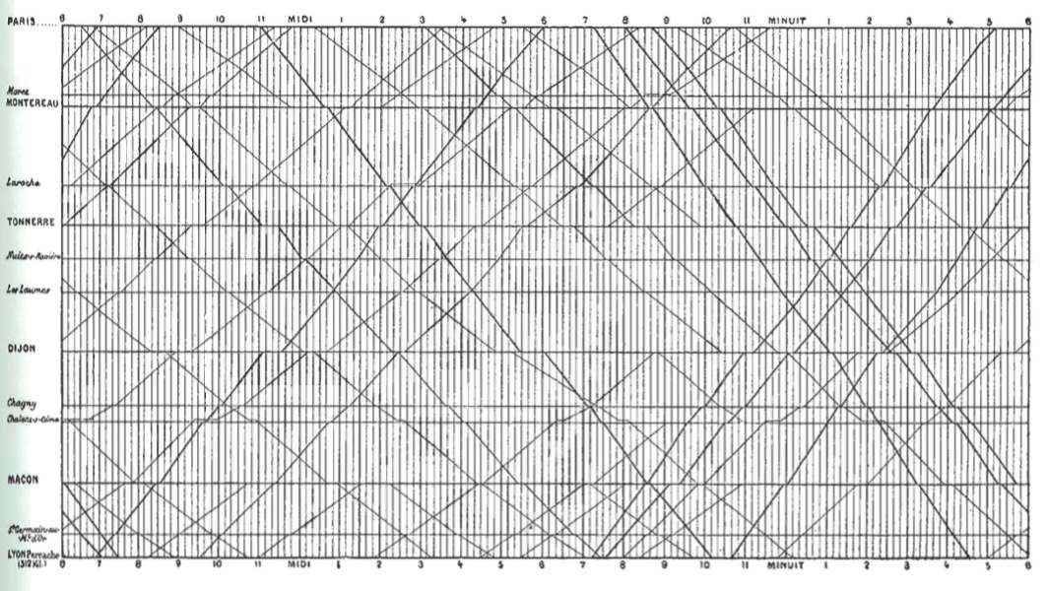
Adding Space to Time
Notes:
Marey’s train graph
What works, what doesn’t?

Slide 12
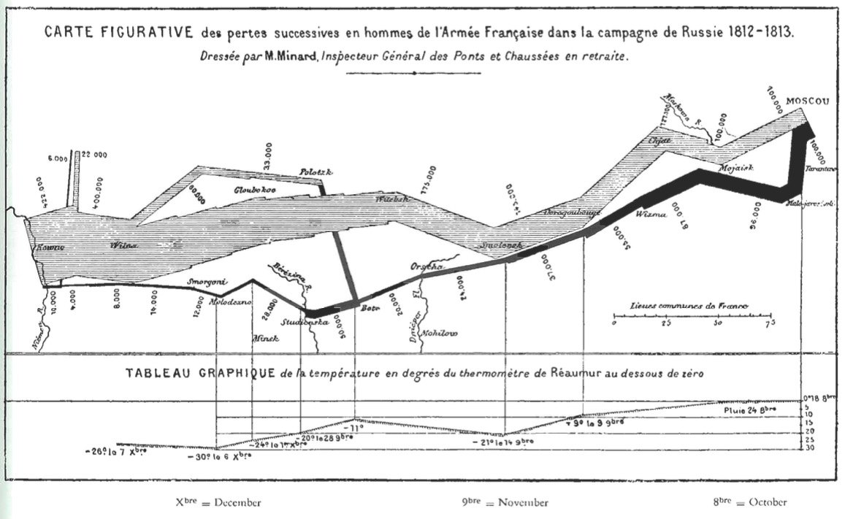
Unifying Maps and Timeseries

Slide 13
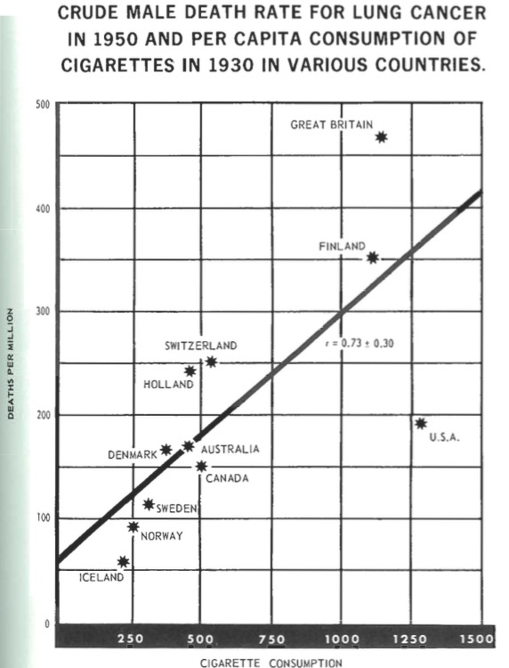
Notes:
Abstract & Statistical Information
1955 Surgeon General’s Report

Slide 14
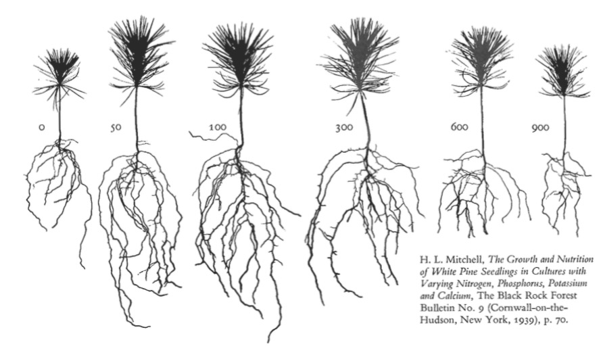
Abstraction Can Tell Wonderful Stories

Slide 15
Data Viz in a Nutshell
History
Graphical Basics
Details to Make Your Viz More Understandable

Slide 16
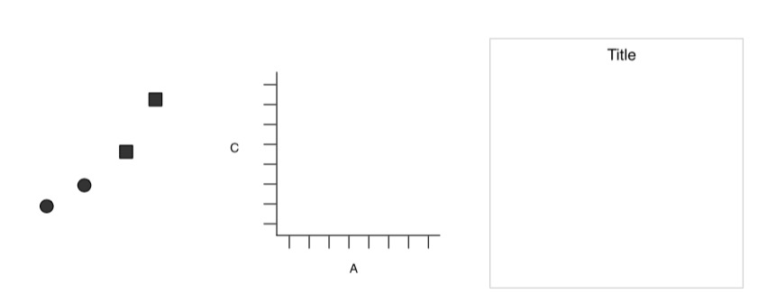
Elements of a Plot
Geometric Objects
Scales & Coordinates
Annotations
Wickham 2010

Slide 17
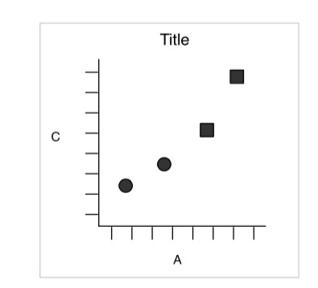
Elements of a Plot
Wickham 2010

Slide 18
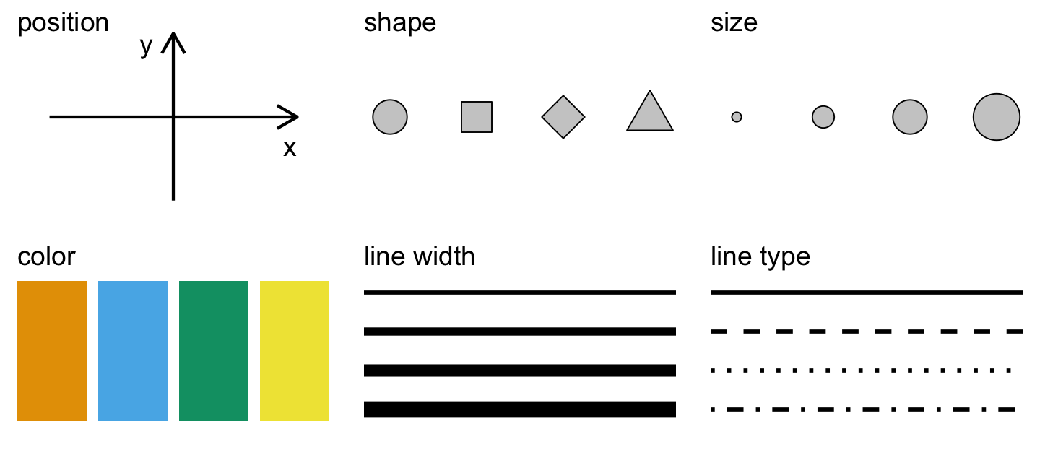
Aesthetics of a Plot
Wilke 2018

Slide 19
Aesthetics Map Data to Visual Representation
Wilke 2018

Slide 20
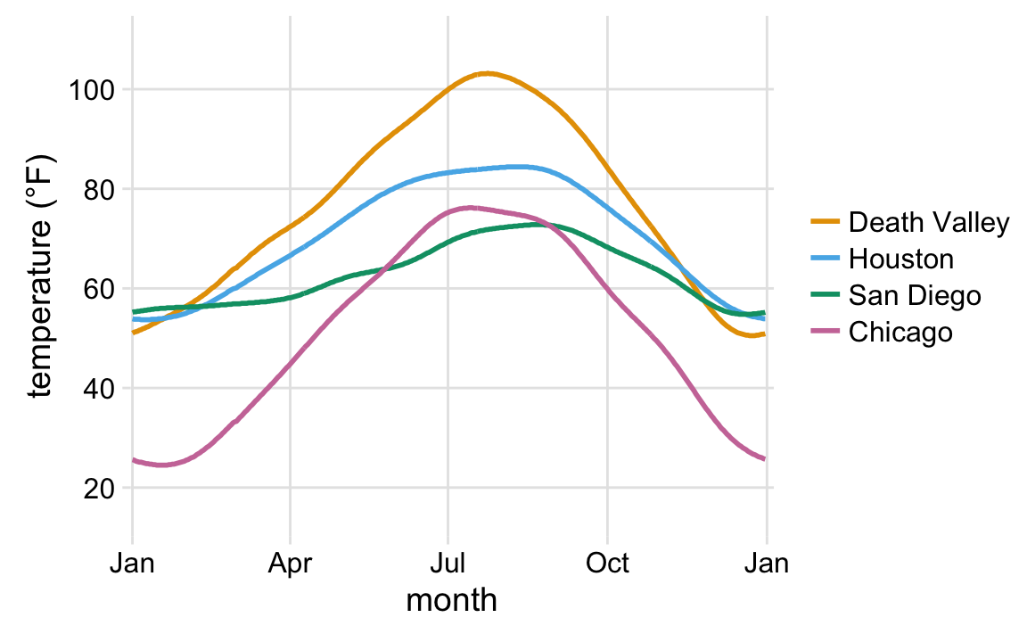
Aesthetics Map Data to Visual Representation
Wilke 2018
Notes:
What do you see here? What’s the story and how do the aesthetics tell it?

Slide 21
Aesthetics Map Data to Visual Representation
Wilke 2018
Notes:
This is the same data
What do you see here? What’s the story and how do the aesthetics tell it?

Slide 22
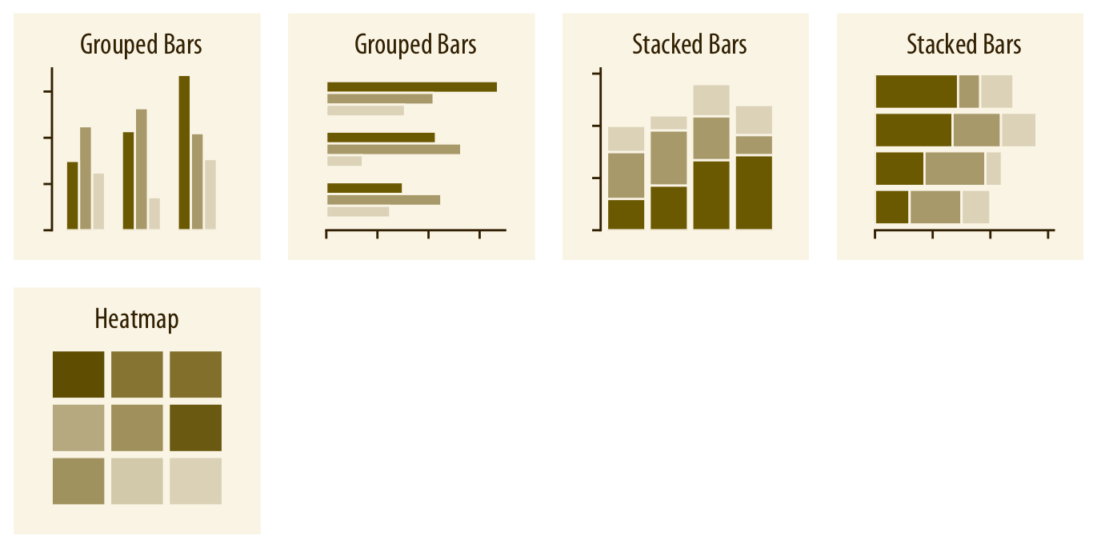
Types of Visualizations: Amounts
Wilke 2018
Notes:
Costs and benefits of each

Slide 23
Types of Visualizations: Amounts
Wilke 2018
Notes:
Costs and benefits of each

Slide 24
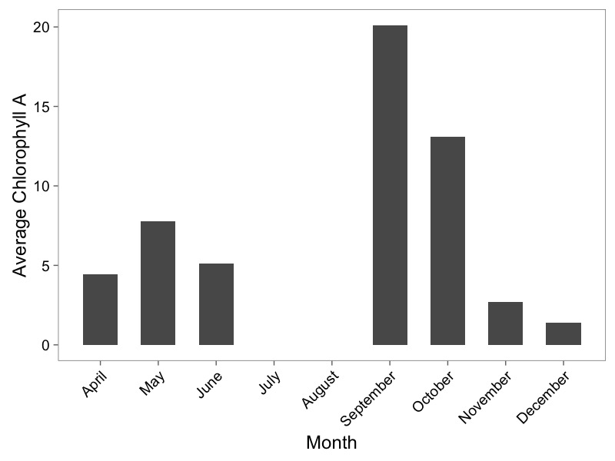
Barplots
Wilke 2018

Slide 25
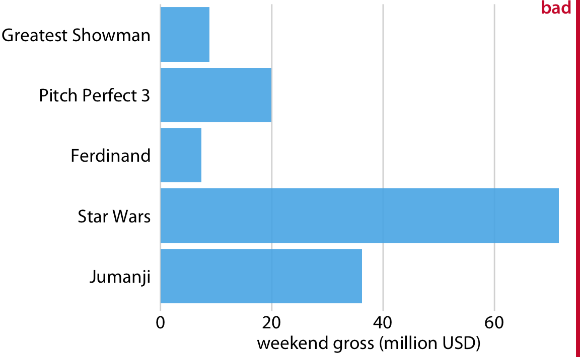
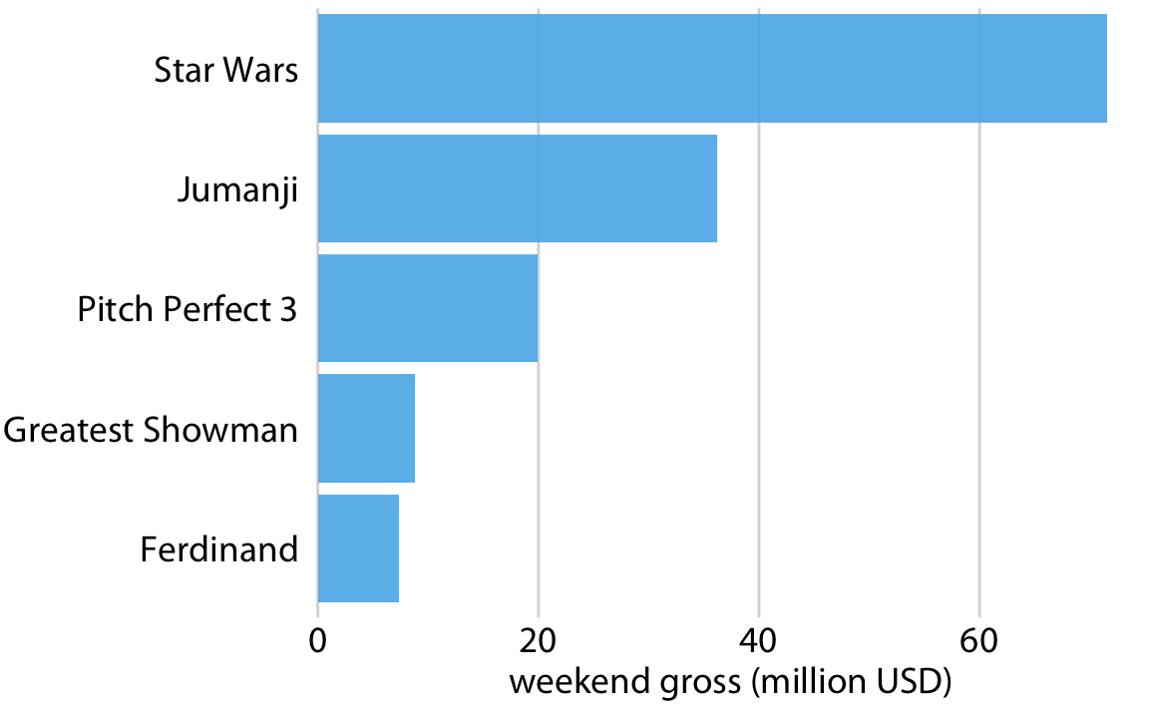
What is Wrong Here?
Wilke 2018

Slide 26
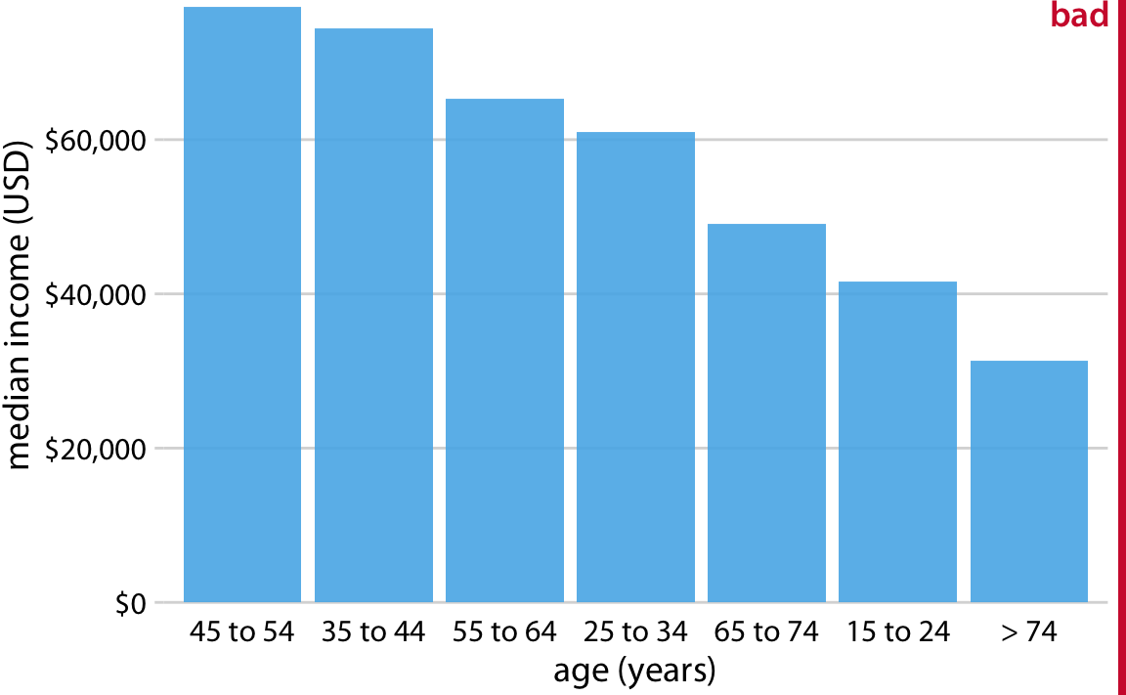
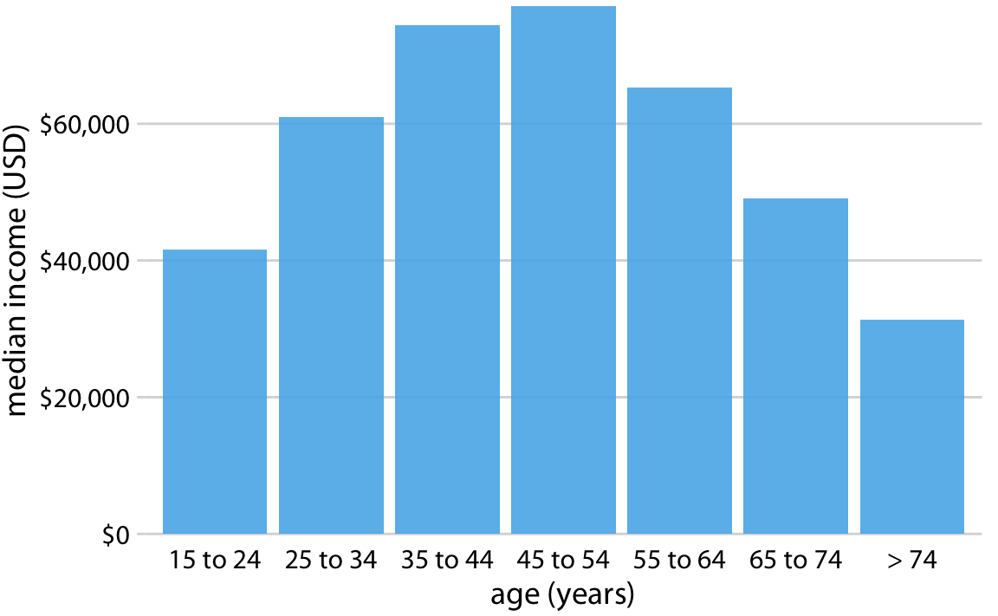
What is Wrong Here?
Wilke 2018

Slide 27
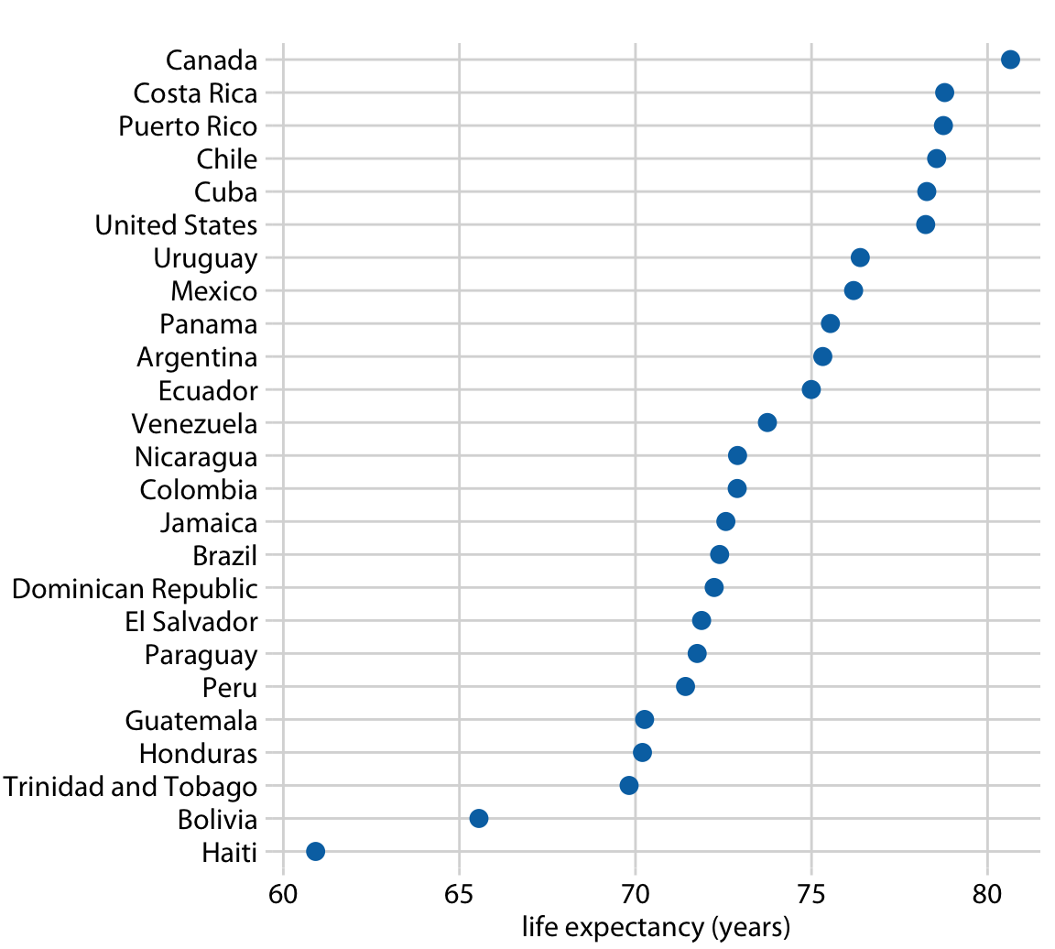
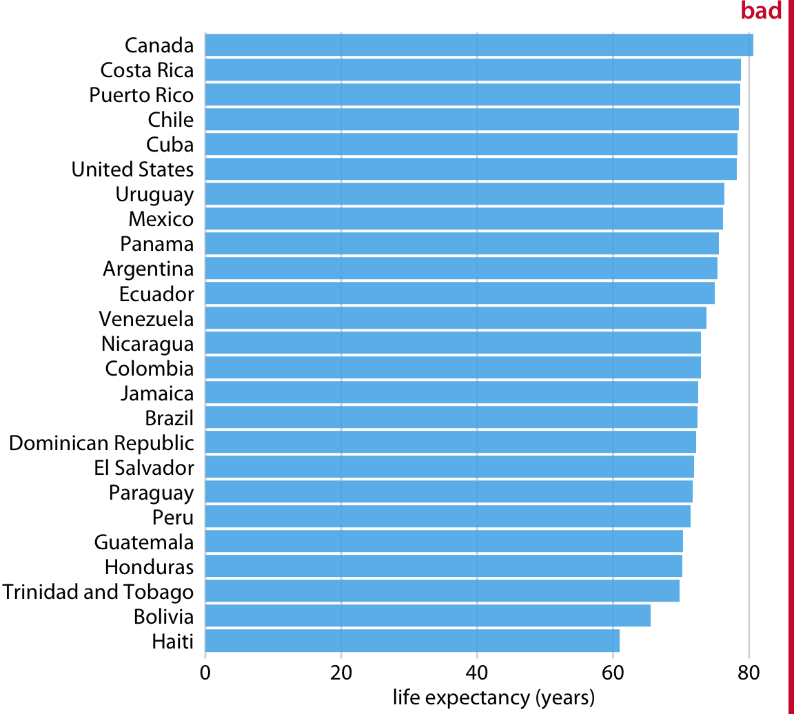
Bars are Not Always Right
Wilke 2018

Slide 28
Types of Visualizations: Distributions
Wilke 2018

Slide 29
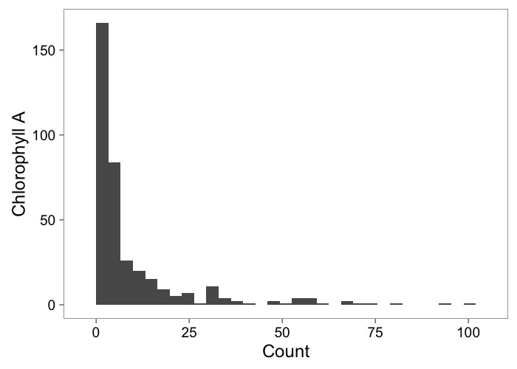
Histograms Show Frequency

Slide 30
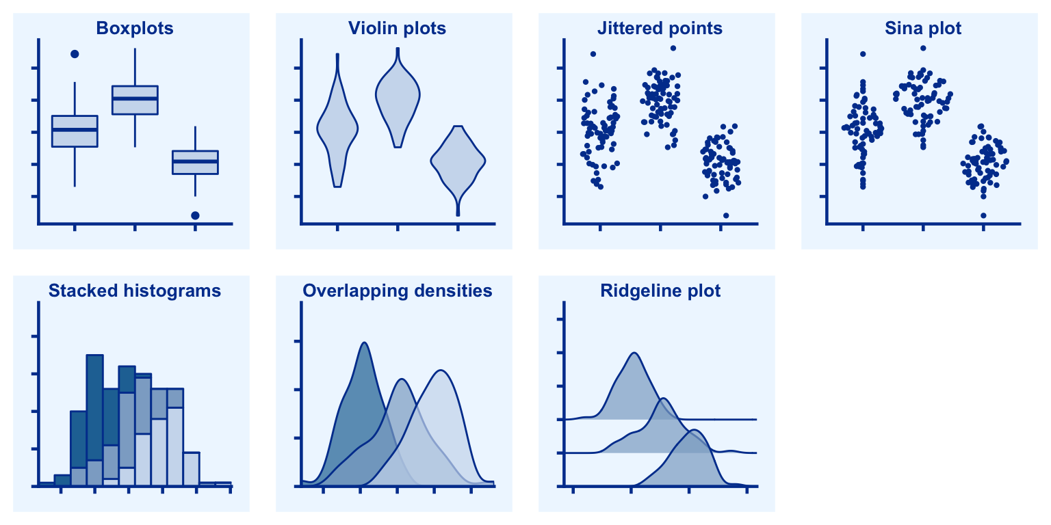
Types of Visualizations: Multiple Distributions
Wilke 2018

Slide 31
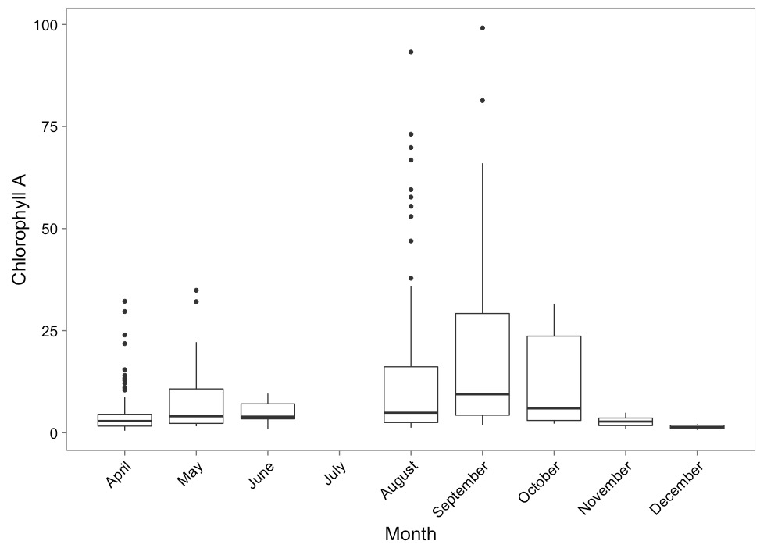
Boxplots to Show Variation

Slide 32
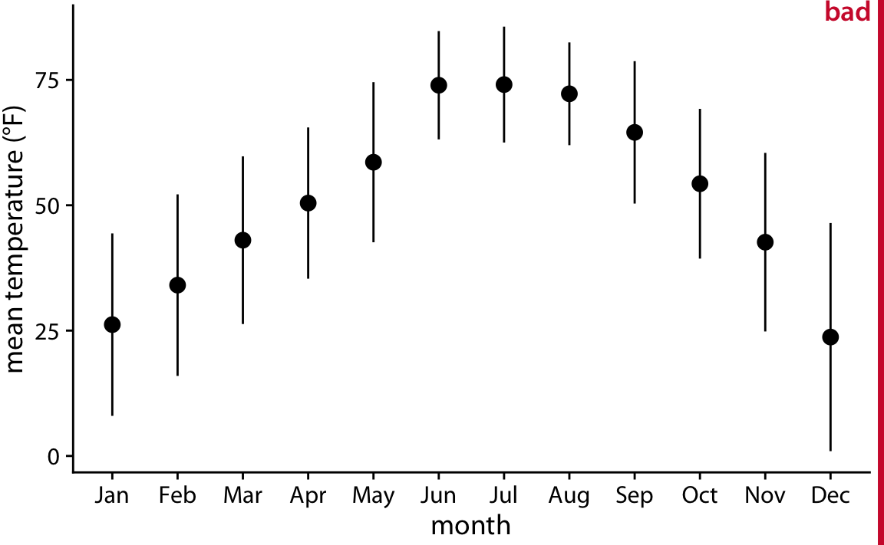
What is Wrong Here if Bars Represent 2SD of Temperature?
Wilke 2018

Slide 33
Visualizing Uncertainty is Difficult
Wilke 2018

Slide 34
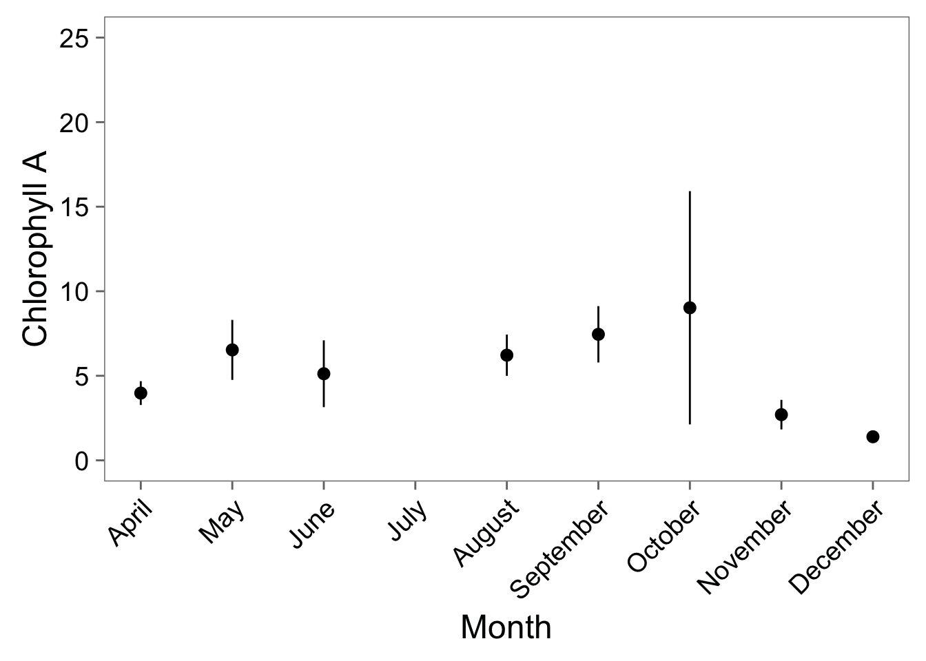
Point-Ranges – but they Don‘t Show All of the Data
Sample versus SamplING distribution

Slide 35
Visualizing Distributions versus Uncertainty
Wilke 2018

Slide 36
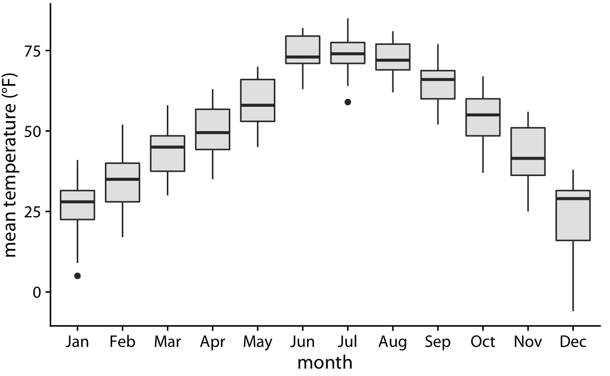
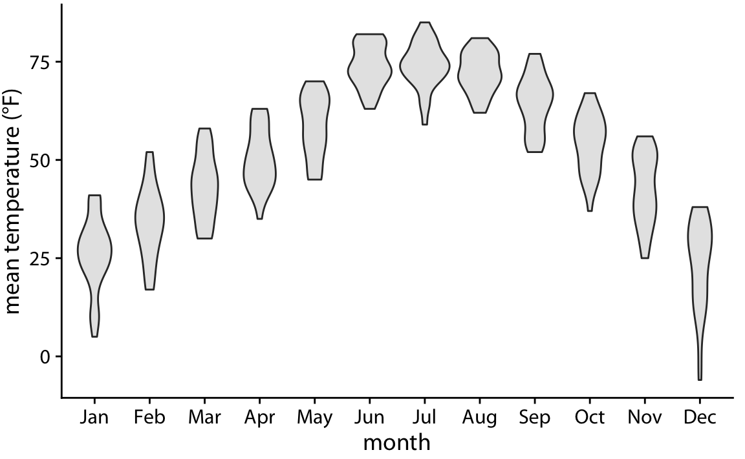
How Does this View Differently?
Wilke 2018

Slide 37
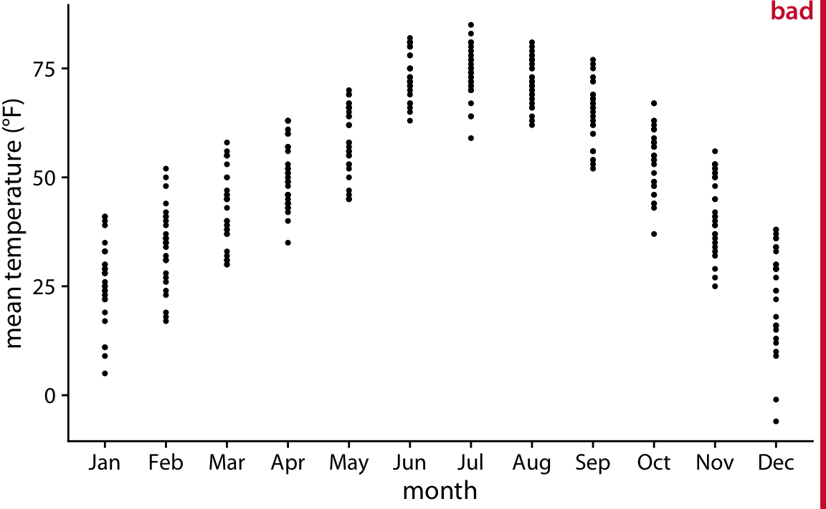
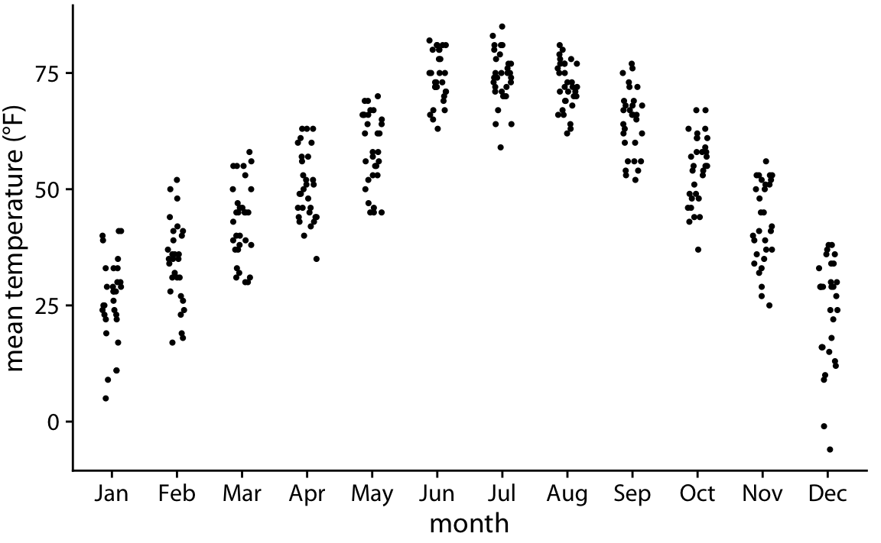
It’s Tempting to Plot Raw Data, but, Be Careful…
Wilke 2018

Slide 38
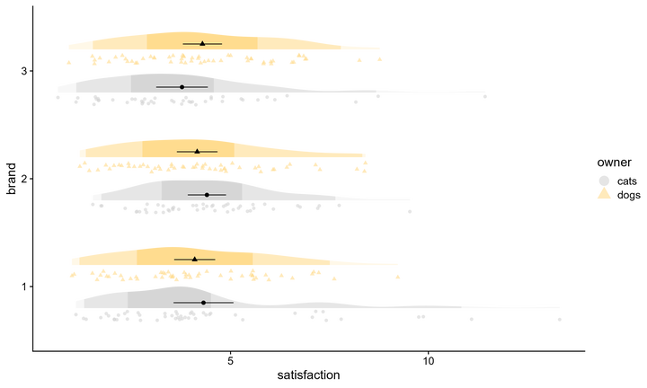
Lots of Ways to Visualize Data, Distribution, and Uncertainty
https://dallasnova.rbind.io/post/efficient-data-visualization-with-faded-raincloud-plots-delete-boxplot/
From rweekly.org 9/5 edition https://rweekly.org/2022-W36.html

Slide 39
Relationships Between Variables
Wilke 2018

Slide 40
Relationships Between Variables With a Lot of Data
Wilke 2018

Slide 41
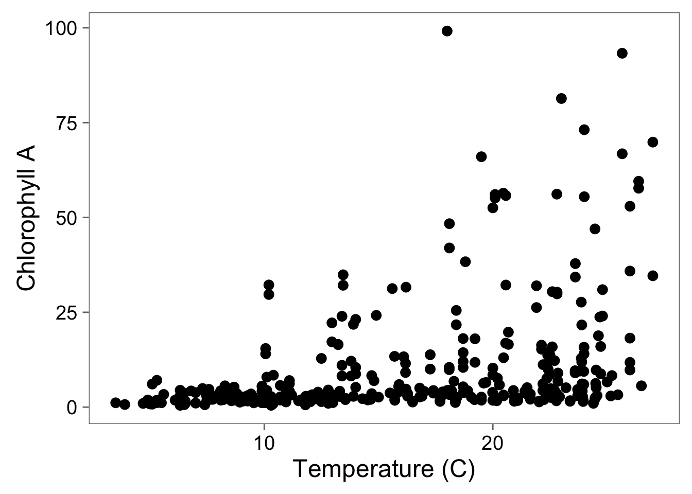
Scatterplots Show Relationships

Slide 42
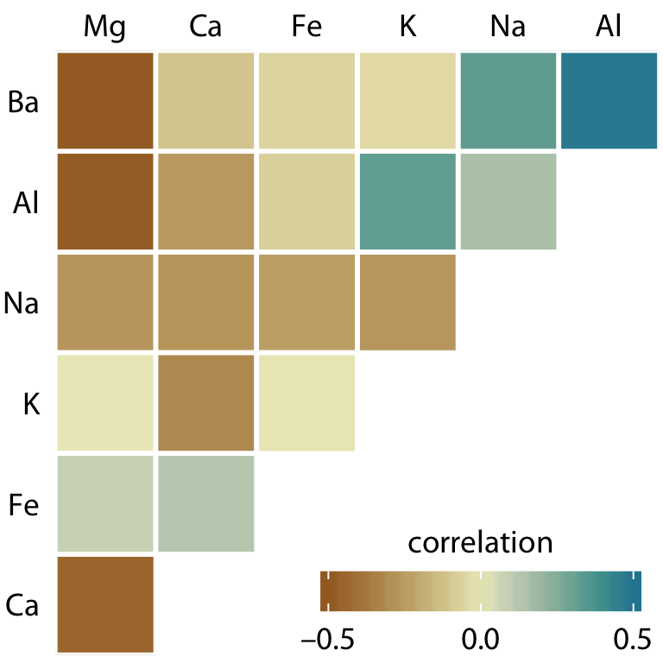
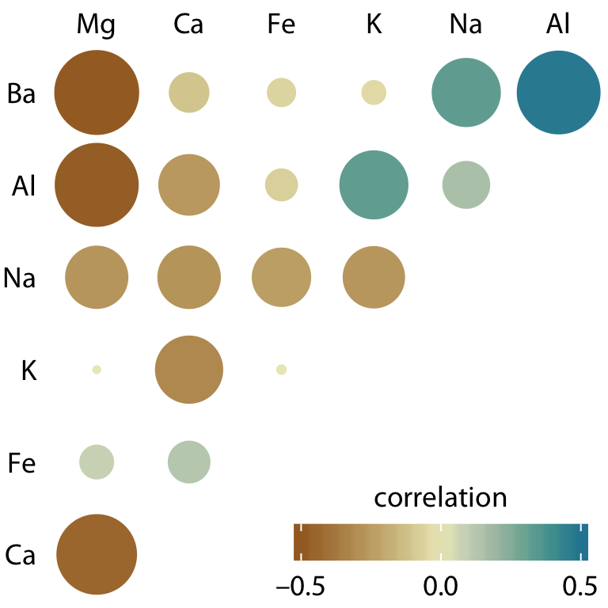
Correlations to Understand Relationships
Wilke 2018

Slide 43
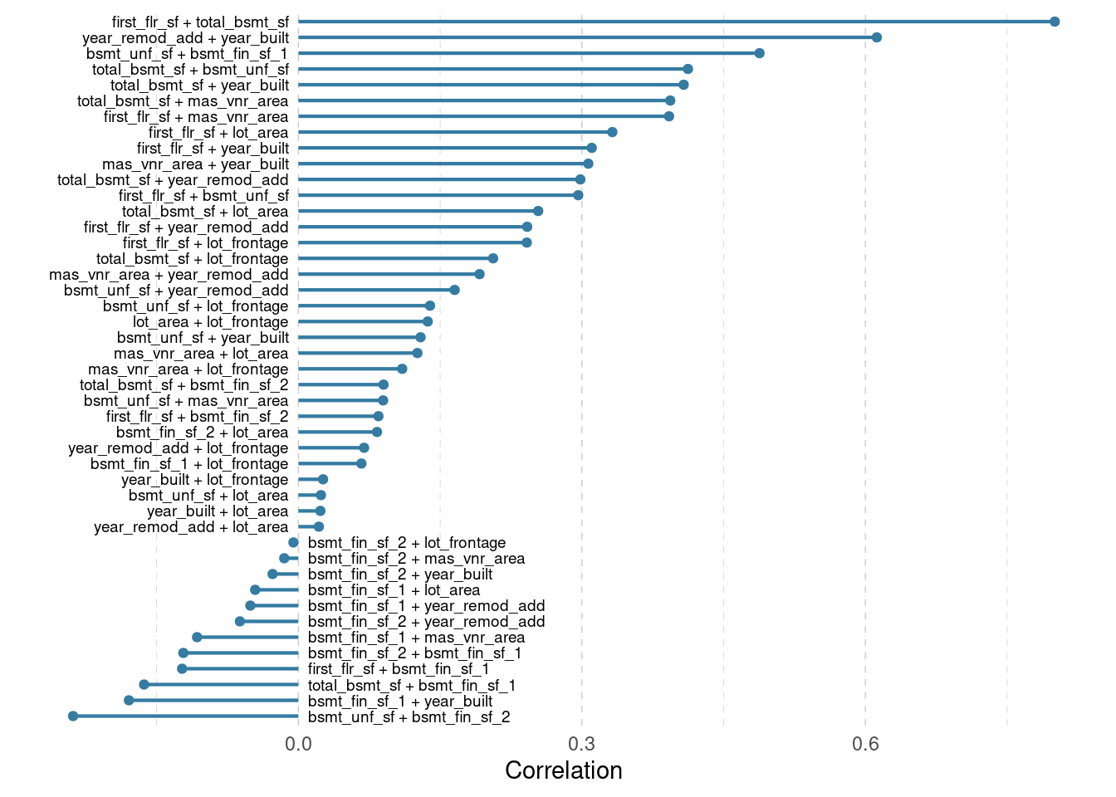
Alternate Ways to View Correlations Efficiently
https://albert-rapp.de/posts/ggplot2-tips/13_alternative_corrplots/13_alternative_corrplots.html

Slide 44
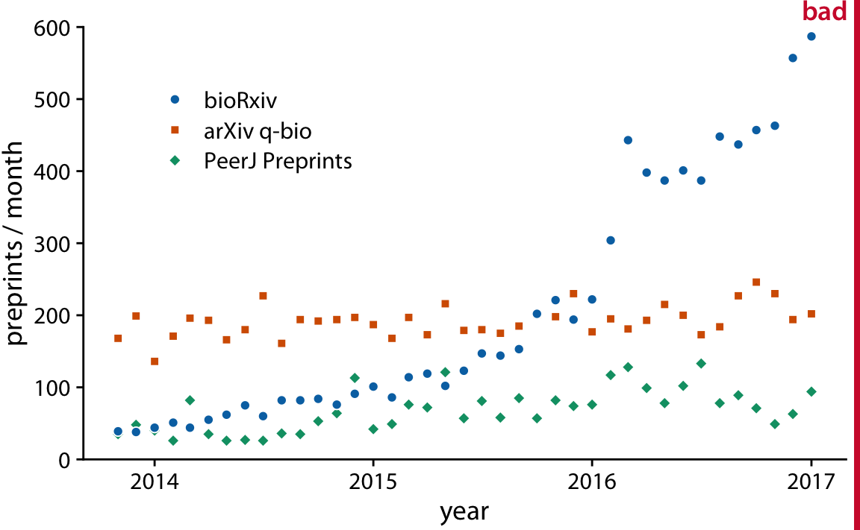
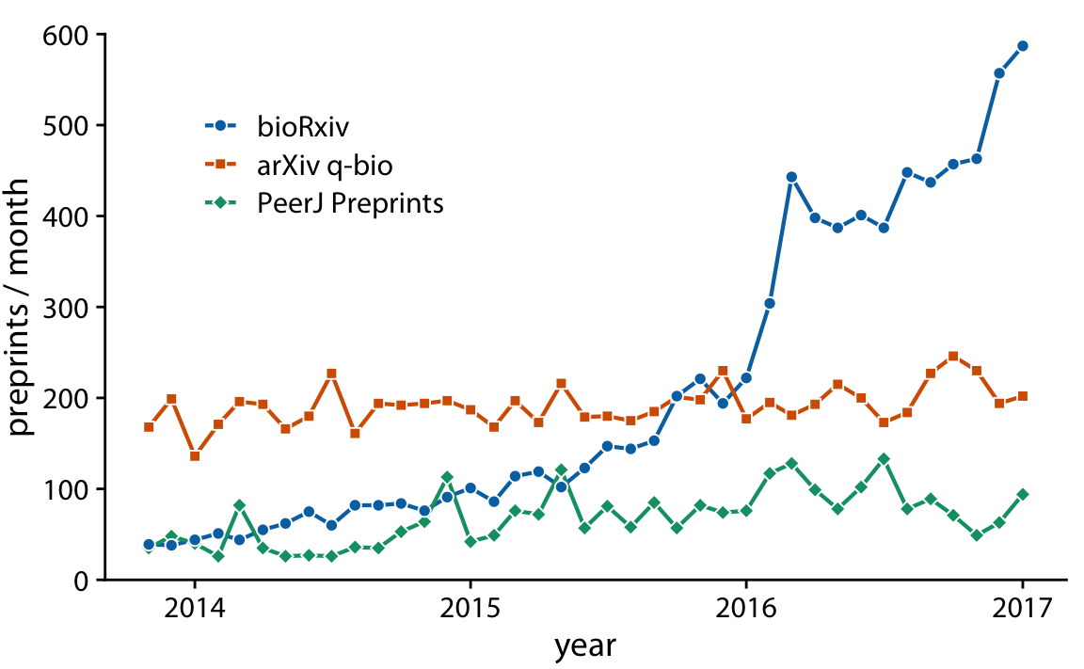
Should Your Data Be Connected?
Wilke 2018

Slide 45
Visualizing Uncertainty in Relationships is Difficult
Wilke 2018

Slide 46
Geospatial Visualization
Wilke 2018

Slide 47
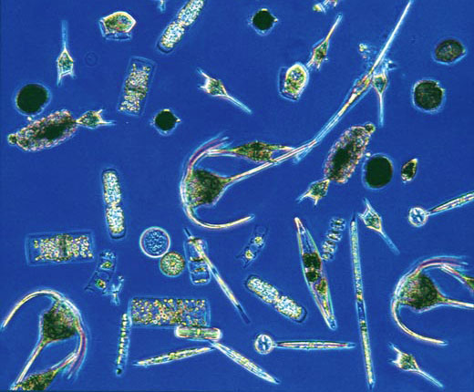
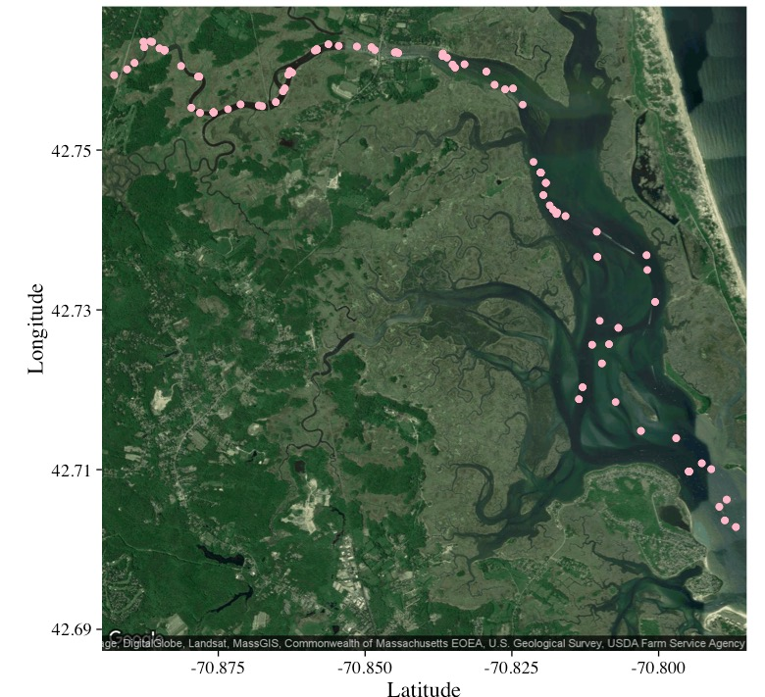
Combining Data Sources and Maps
Chlorophyll a
Abundance of taxonomic groups
Temperature
Salinity
Hopkinson and Hobbie 2012 http://ecosystems.mbl.edu/PIE/data/EST/EST-PR-ChemTax.html

Slide 48
Data Viz in a Nutshell
History
Graphical Basics
Details to Make Your Viz More Understandable

Slide 49
Coordinate Systems Transform Relationships

Slide 50
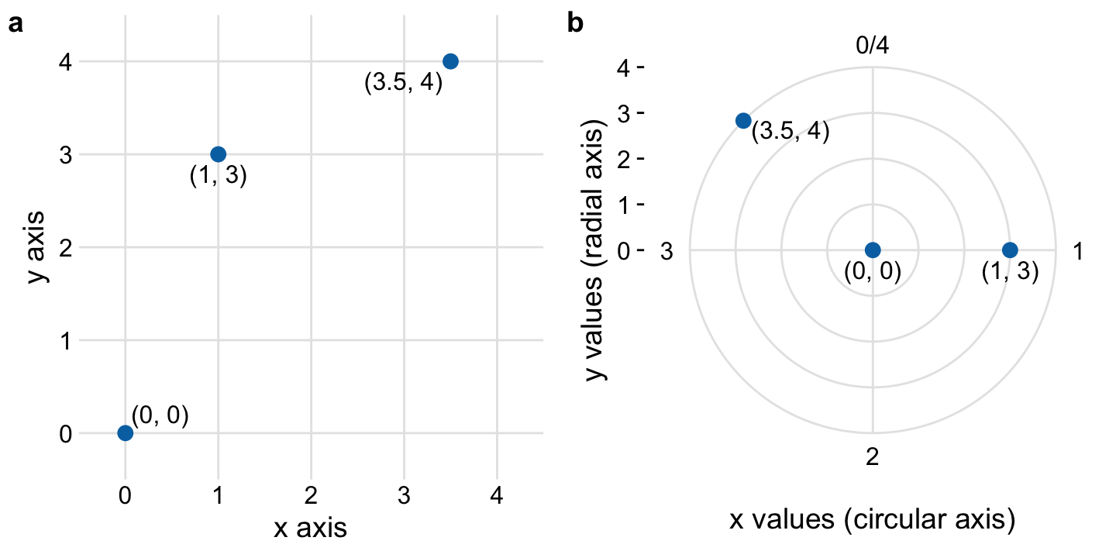
The Polar Coordinate System is Useful!
Wilke 2018

Slide 51
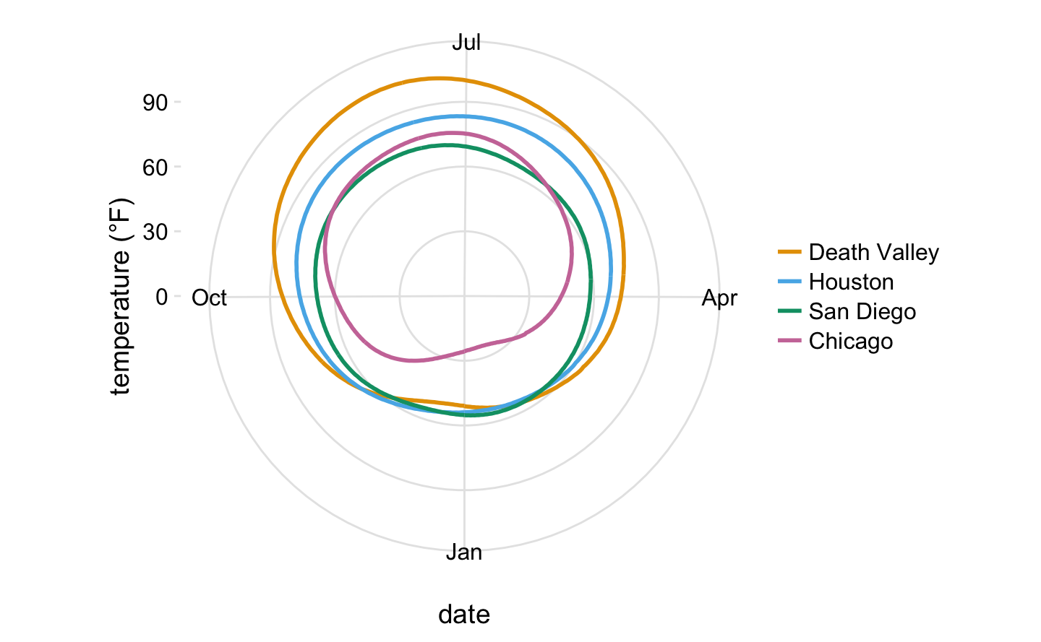
The Polar Coordinate System is Useful!
Wilke 2018

Slide 52
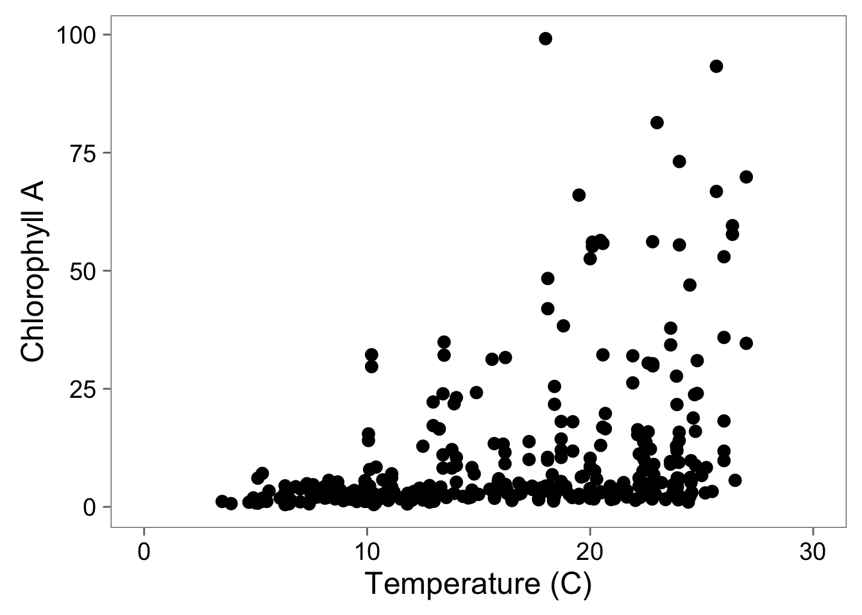
Adding Full Scale to 0

Slide 53
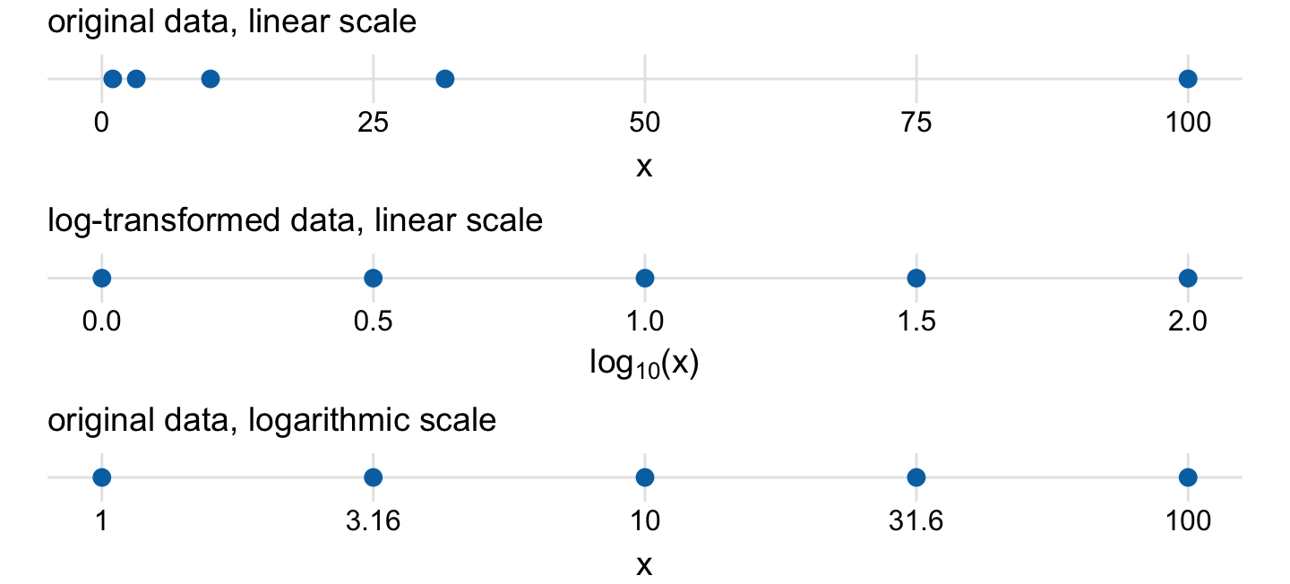
Why Transform?
Wilke 2018

Slide 54
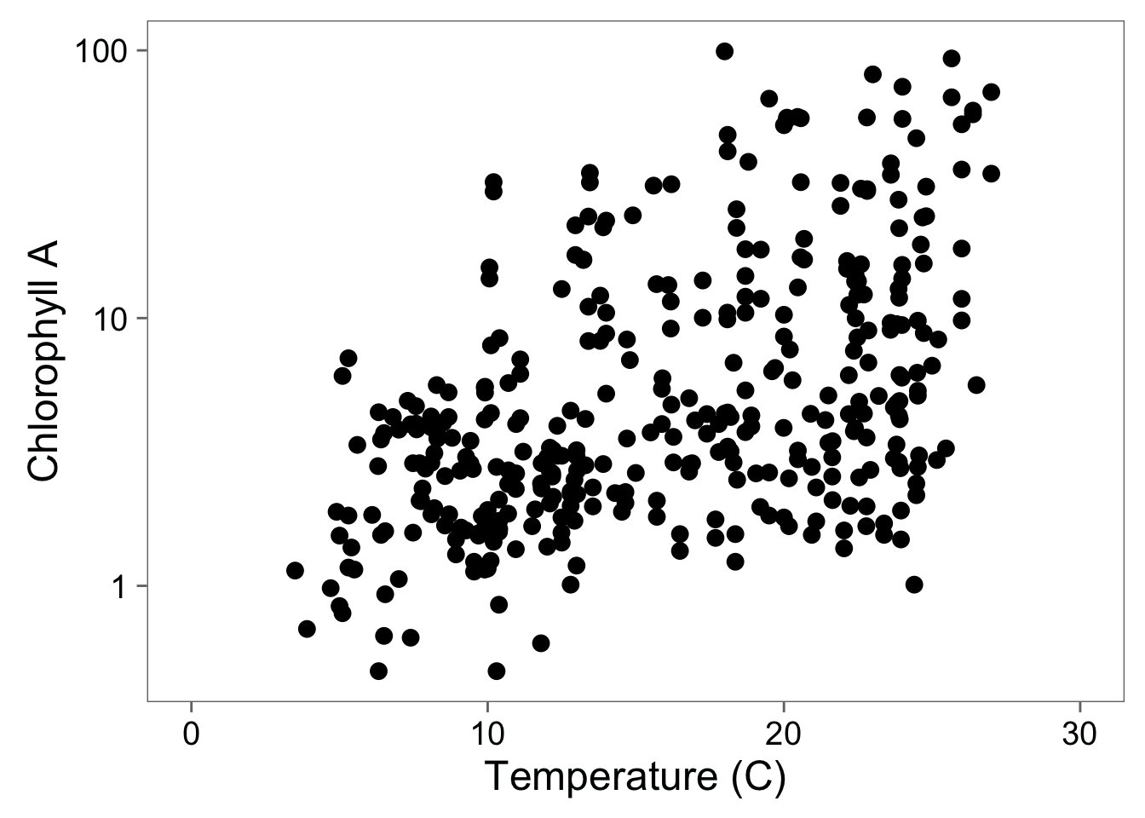
Log-Transformation To See Relationship

Slide 55
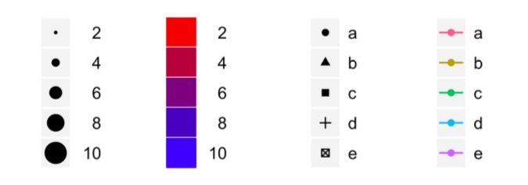
Scales to Add Dimensions of Data

Slide 56
Colors Can Distinguish Groups
Wilke 2018

Slide 57
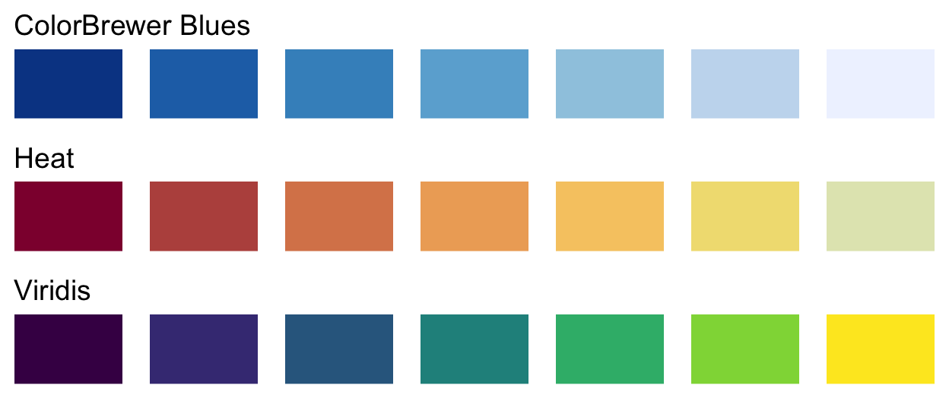
Colors Can Show Data
Wilke 2018

Slide 58
Beware Not Thinking About Color Blindness
Never use Red-Green!
Use redundant coding: shapes, sizes, etc.
Wilke 2018

Slide 59
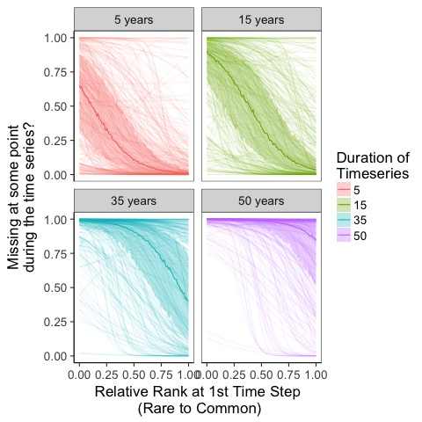
Redundant Coding

Slide 60
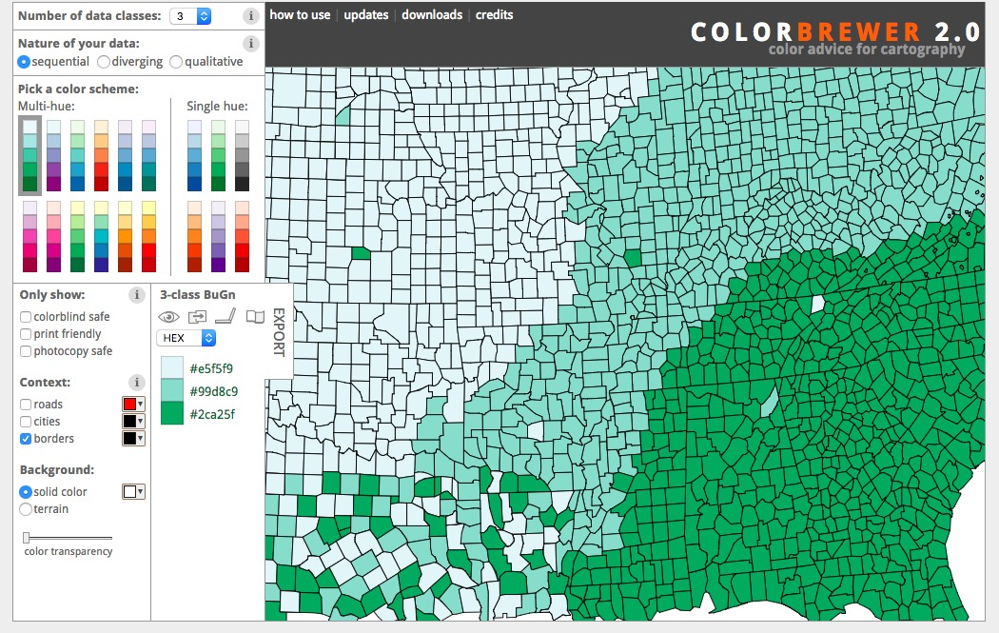
Colorbrewer.org
See also https://flowingdata.com/tag/color/

Slide 61
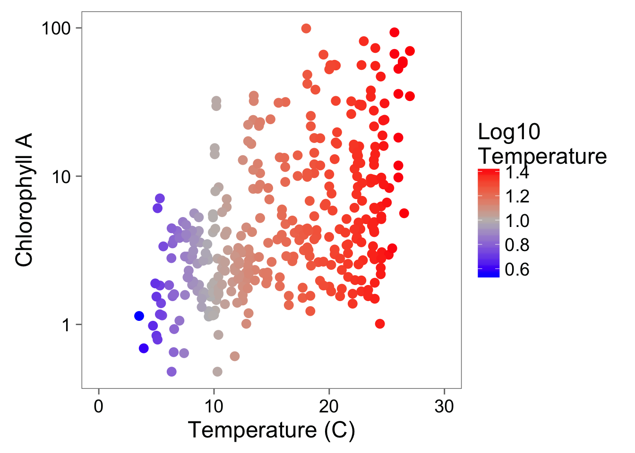
A Touch of Color!

Slide 62
Color Can Bring in Another Dimension

Slide 63
Statistical Fit to Aid Understanding

Slide 64
Facets to Add Fine-Grained Information or New Dimensions

Slide 65
Facets Add Information

Slide 66
Finally: Minimalist Presentation
Above all else show data.
2. Maximize the data-ink ratio
3. Erase non-data-ink.
4. Erase redundant data-ink.
Tufte 2002

Slide 67
Show the Data

Slide 68
Notes:
Thoughts here?

Slide 70
Next time…
Colin Fay

