Slide 1
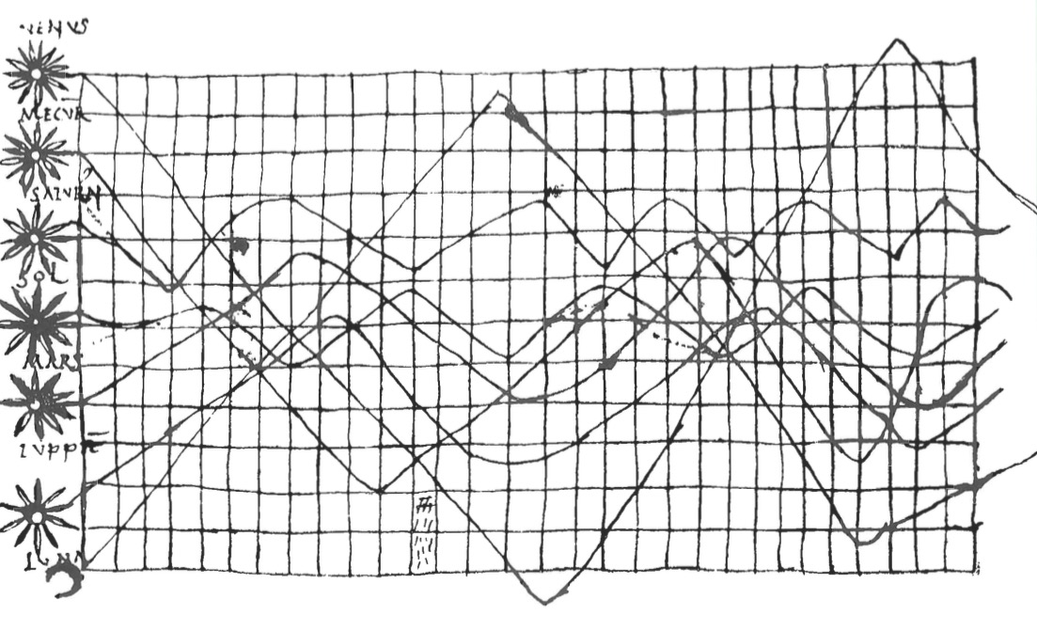
Data Visualization
Notes:
Reorganize – gets very choppy

Slide 2
Data visualization is Communication

Slide 3
Principles of Graphical Excellence
Clarity
Precision
Efficiency
Maximize ideas, minimize ink
(from Tufte)

Slide 4
Data Viz in a Nutshell
History
Graphical Basics
Minimalist principles

Slide 5
Data Viz in the 10th Century
From Funkhouser 1936
Notes:
10th century
What do you see here. What works. What does not?

Slide 6
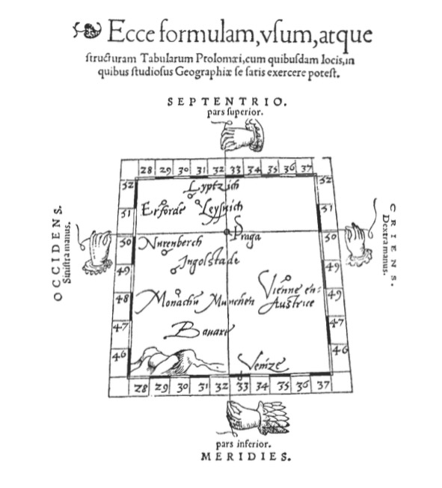
Notes:
Early maps. Little information beyond intersections – 1546 from Pedrus Apenius
What do you get from this?

Slide 7
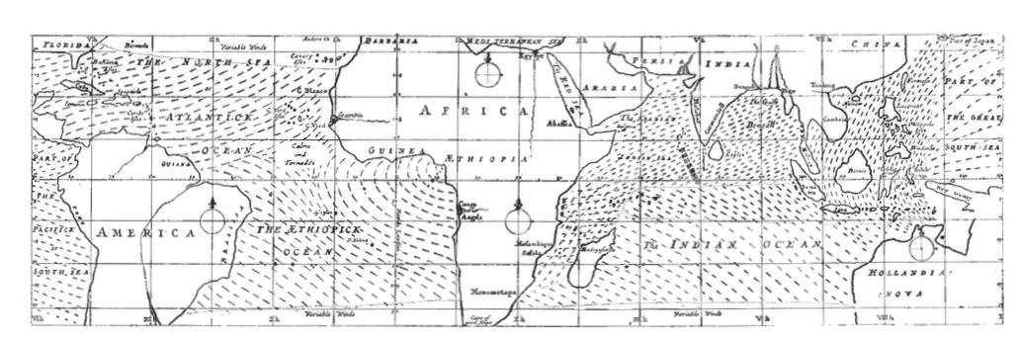
Maps as Rich Information Source
Notes:
Edmond Halley 1686

Slide 8
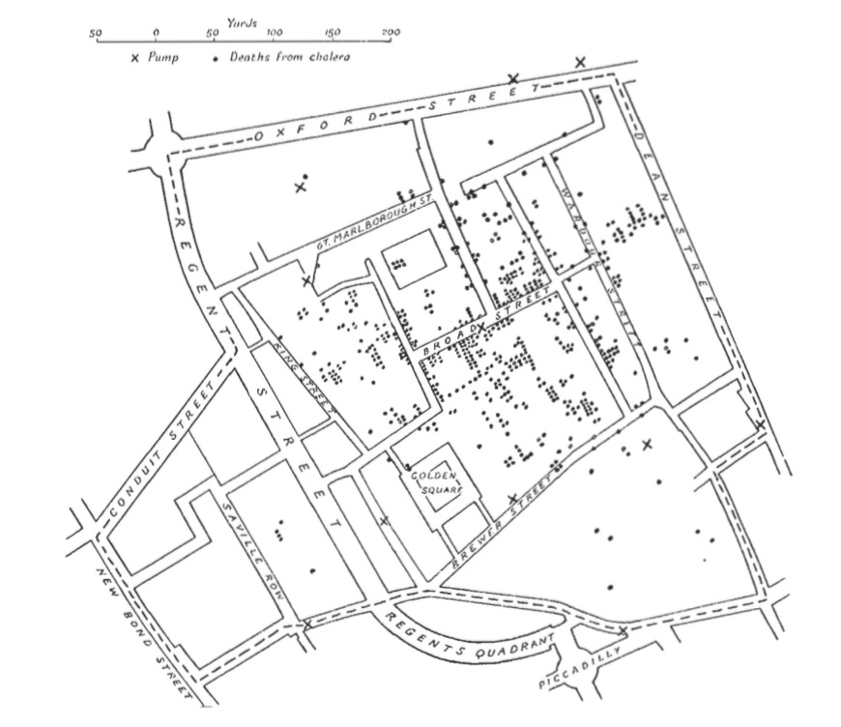
Spatial Patterns Intuitive
Notes:
How would you make this abstract?
John Snow 1854
It’s not all maps – timeseries, particularly as govs started getting into data

Slide 9
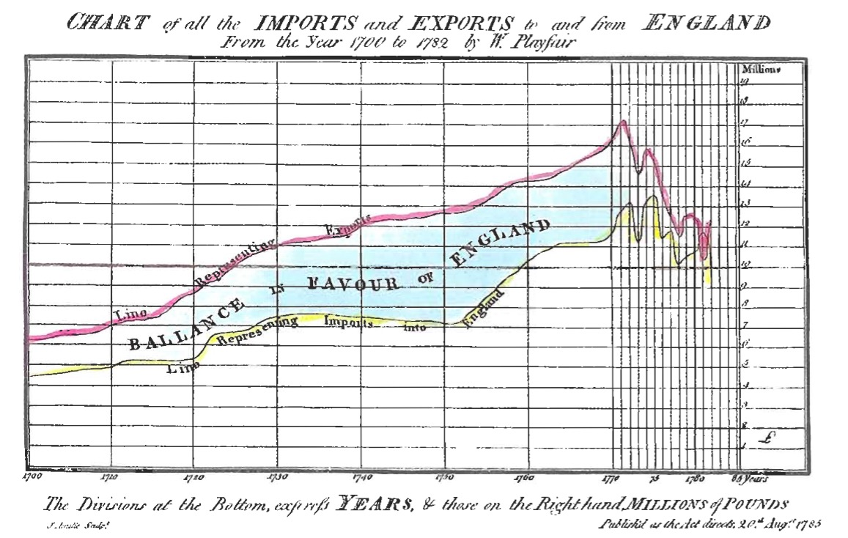
Notes:
Playfair! A father of modern statistical graphics

Slide 10
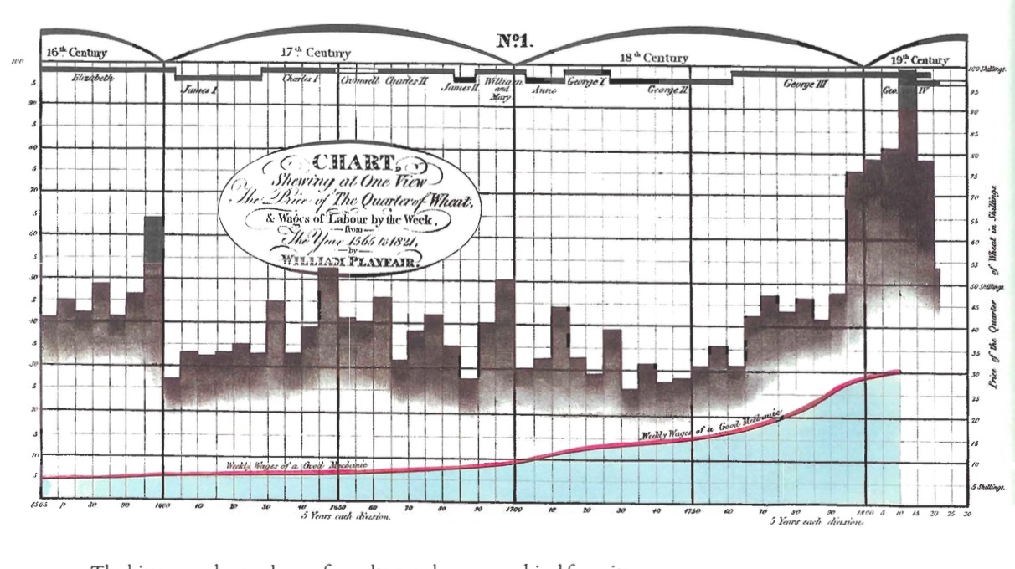
Multiple Data Sources to Make a Point

Slide 11
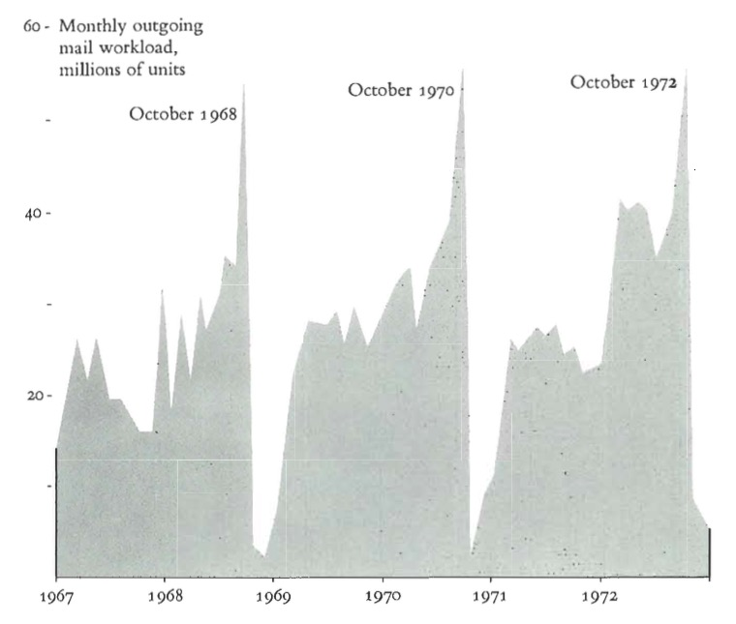
Sometimes One Variable is Enough

Slide 12
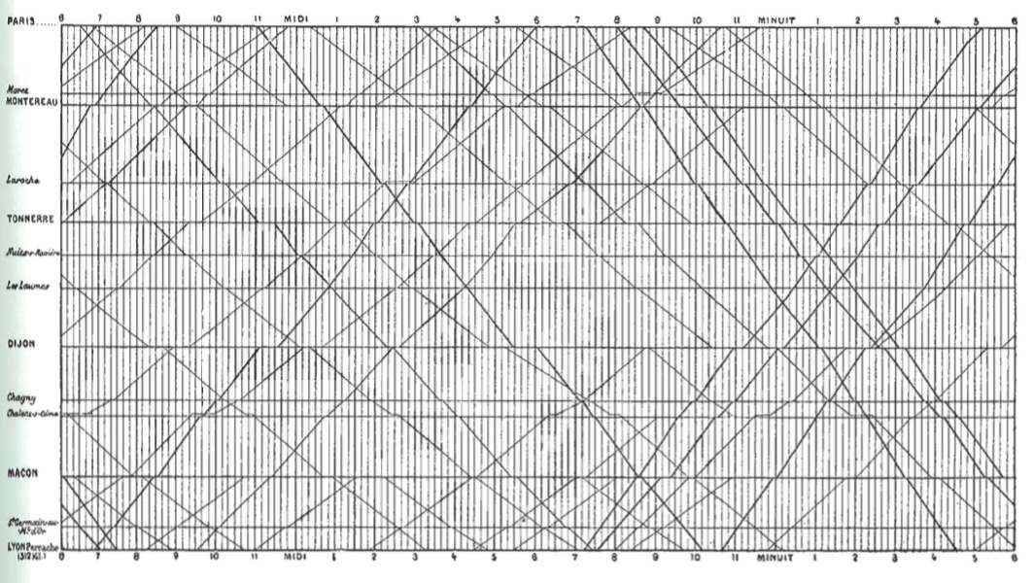
Adding Space to Time
Notes:
Marey’s train graph
What works, what doesn’t?

Slide 13
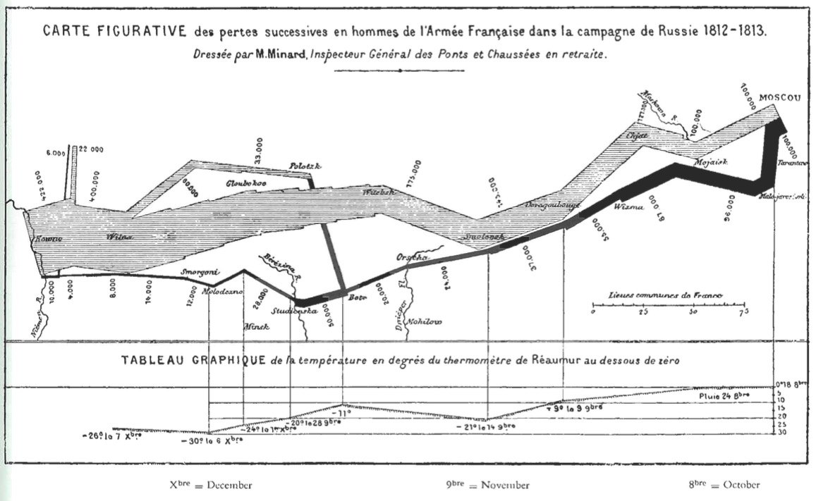
Unifying Maps and Timeseries

Slide 14
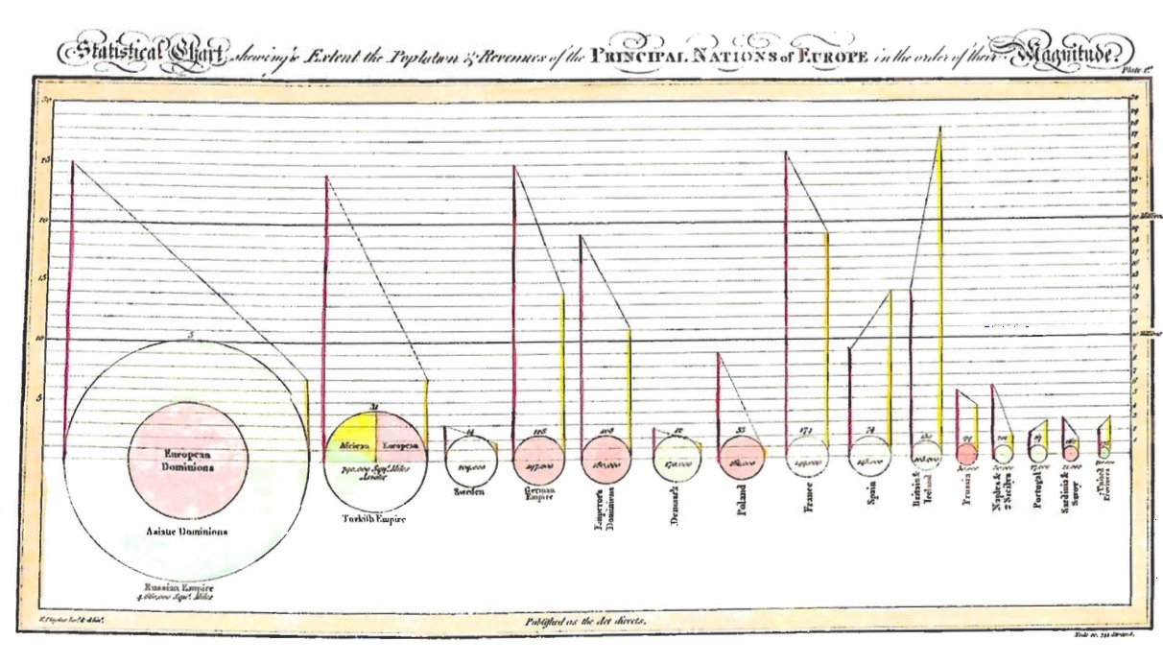
Abstracting Variables to Make a Point
Notes:
Playfair again!

Slide 15
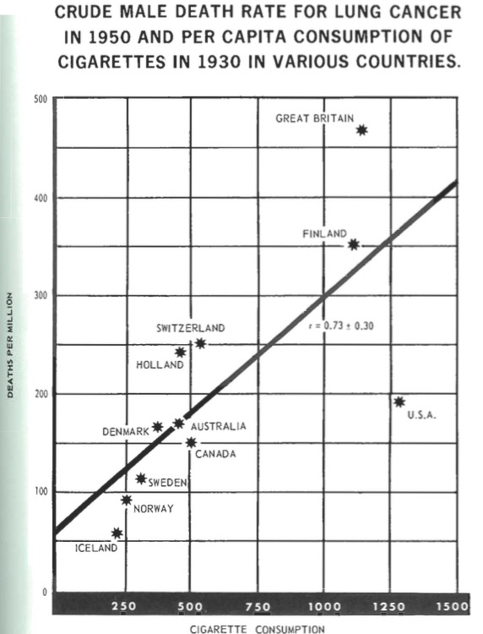
Notes:
Abstract & Statistical Information
1955 Surgeon General’s Report

Slide 16
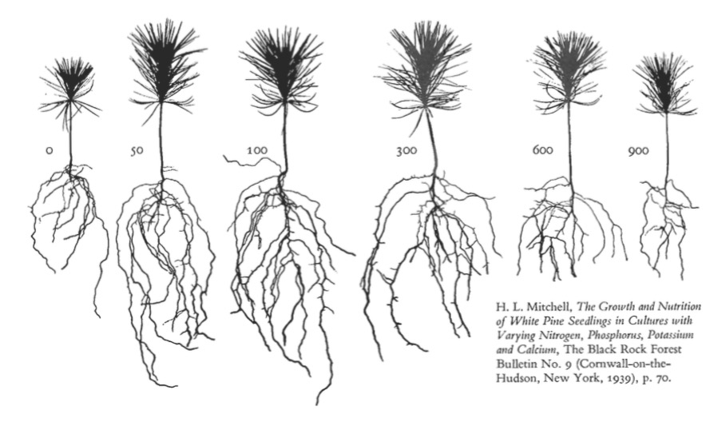
Abstraction Can Tell Wonderful Stories

Slide 17
Data Viz in a Nutshell
History
Graphical Basics
Minimalist principles

Slide 18
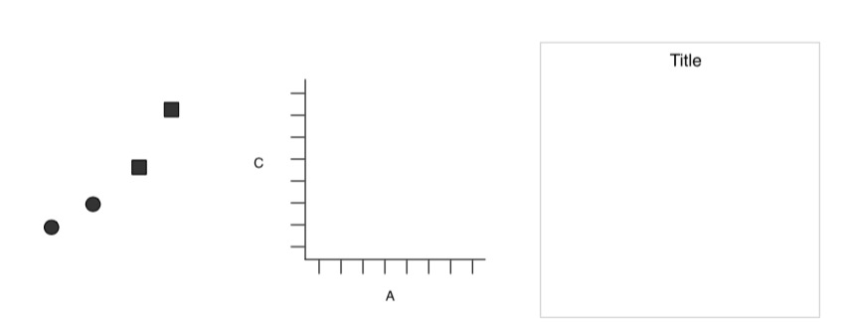
Elements of a Plot
Geometric Objects
Scales & Coordinates
Annotations
Wickham 2010

Slide 19
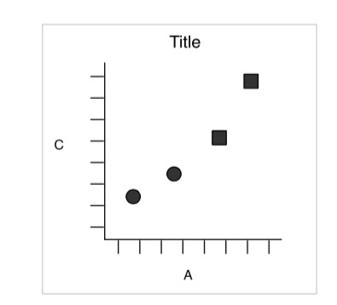
Elements of a Plot
Wickham 2010

Slide 20
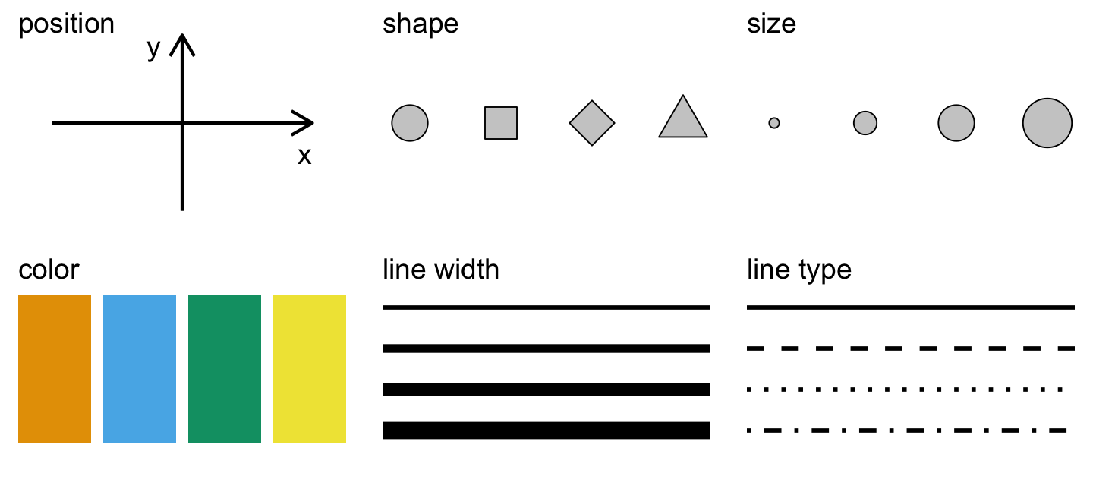
Aesthetics of a Plot
Wilke 2018

Slide 21
Aesthetics Map Data to Visual Representation
Wilke 2018

Slide 22
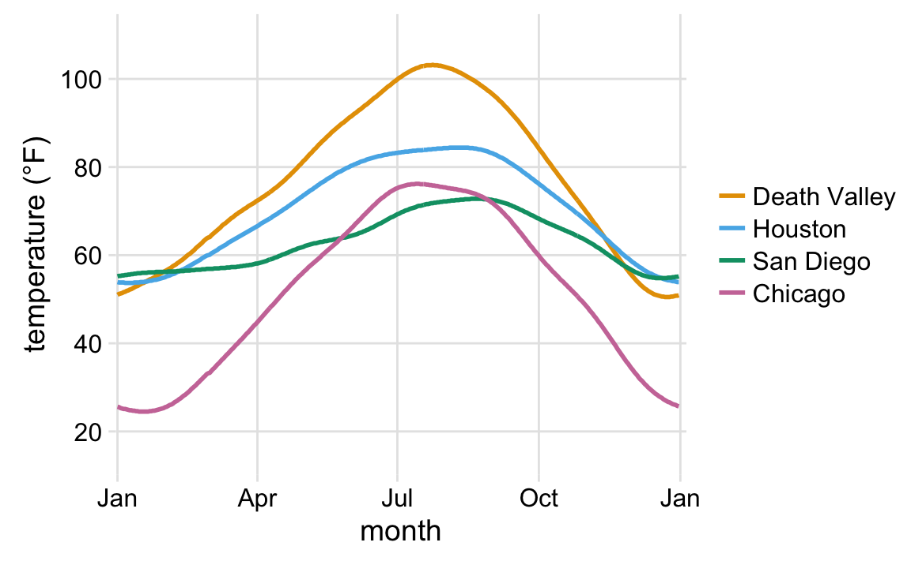
Aesthetics Map Data to Visual Representation
Wilke 2018
Notes:
What do you see here? What’s the story and how do the aesthetics tell it?

Slide 23
Aesthetics Map Data to Visual Representation
Wilke 2018
Notes:
This is the same data
What do you see here? What’s the story and how do the aesthetics tell it?

Slide 24
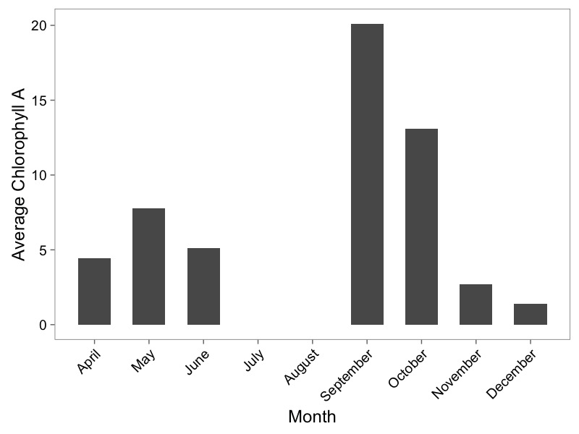
Barplots

Slide 25
Types of Visualizations: Proportions
Wilke 2018
Notes:
Costs and benefits of each

Slide 26
Types of Visualizations: Multiple Proportions
Wilke 2018
Notes:
Costs and benefits of each

Slide 27
Types of Visualizations: Distributions
Wilke 2018

Slide 28
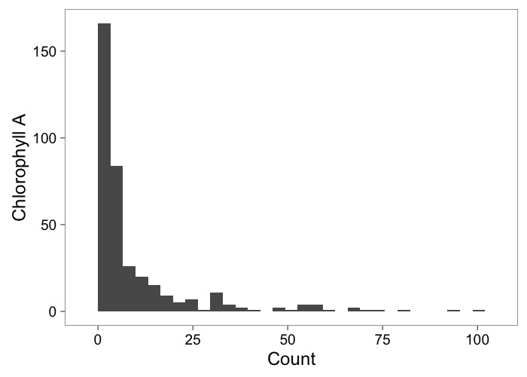
Histograms Show Frequency

Slide 29
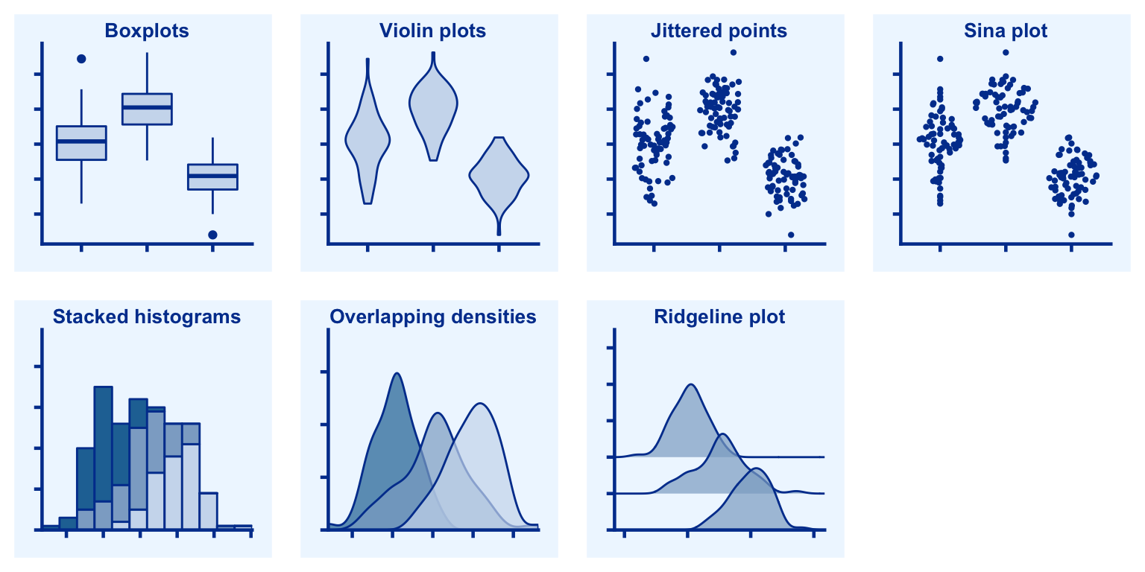
Types of Visualizations: Multiple Distributions
Wilke 2018

Slide 30
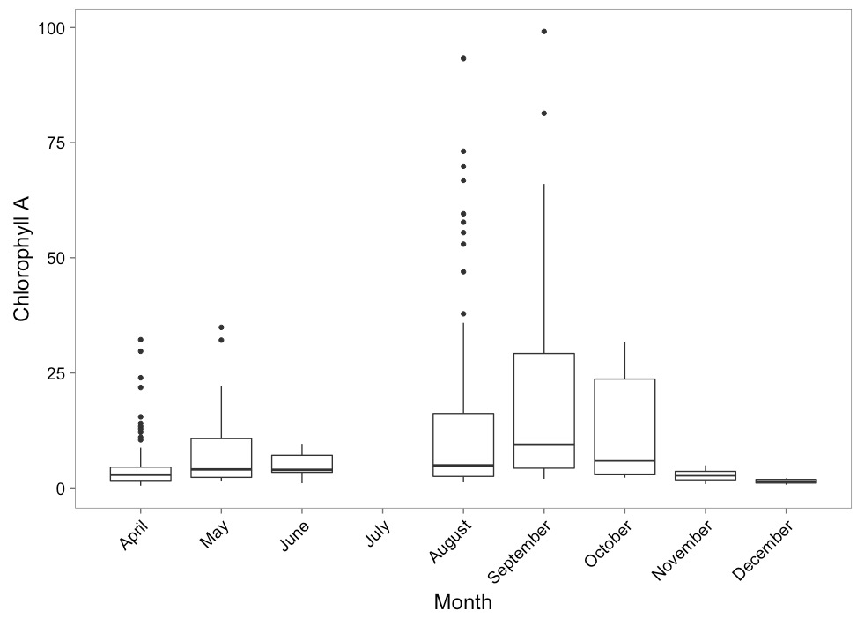
Boxplots to Show Variation

Slide 31
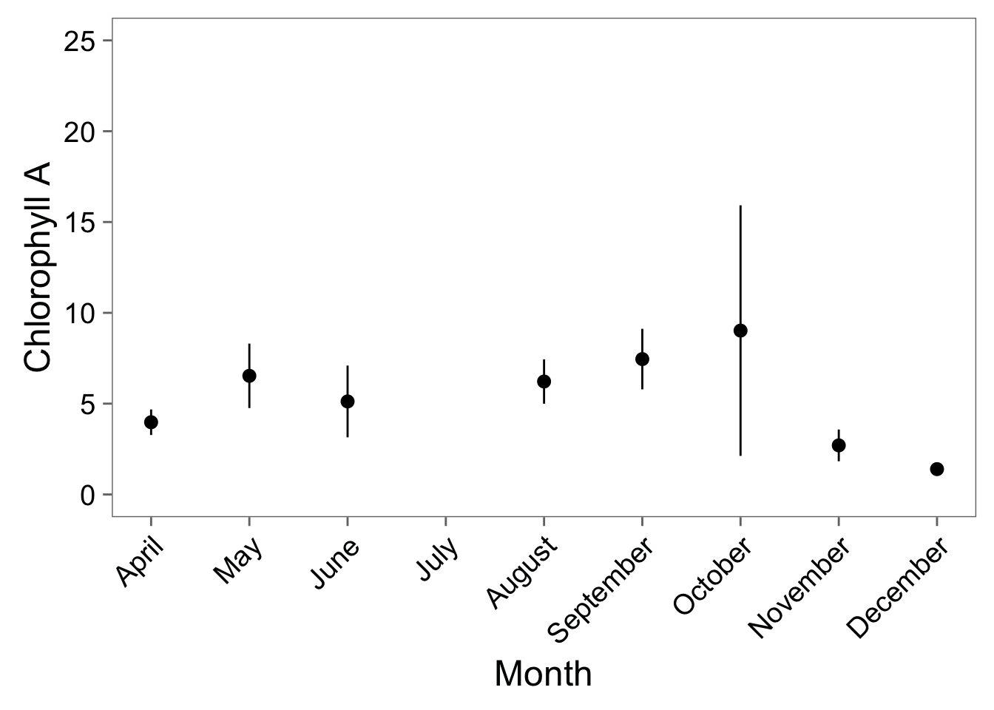
…Or Point-Ranges

Slide 32
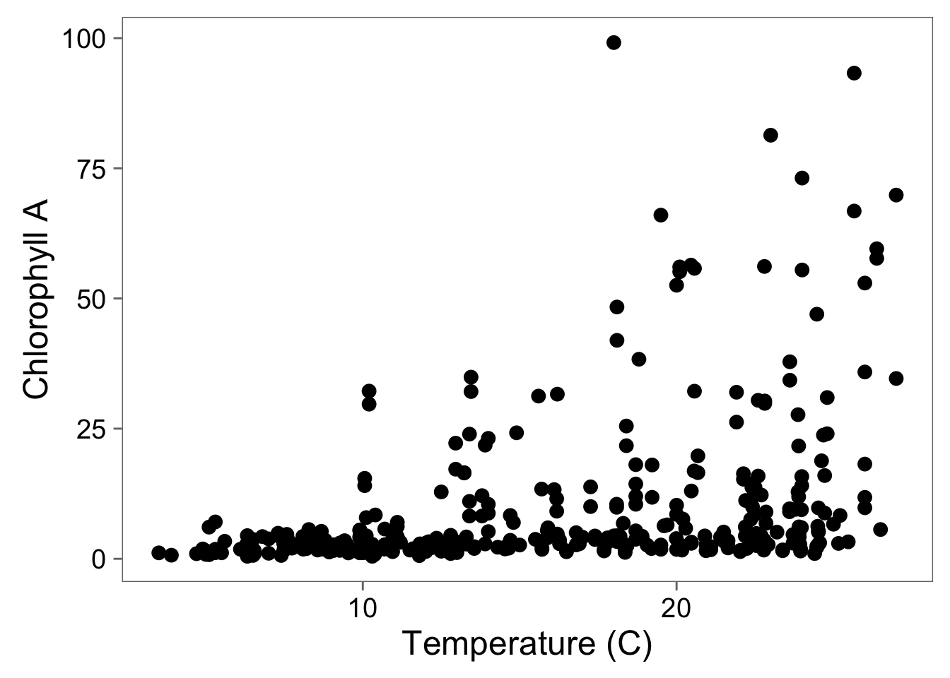
Scatterplots Show Relationships

Slide 33
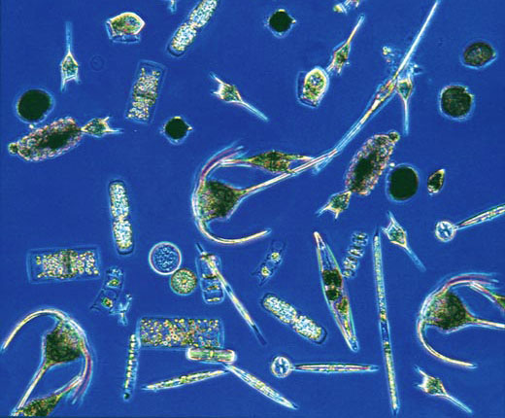
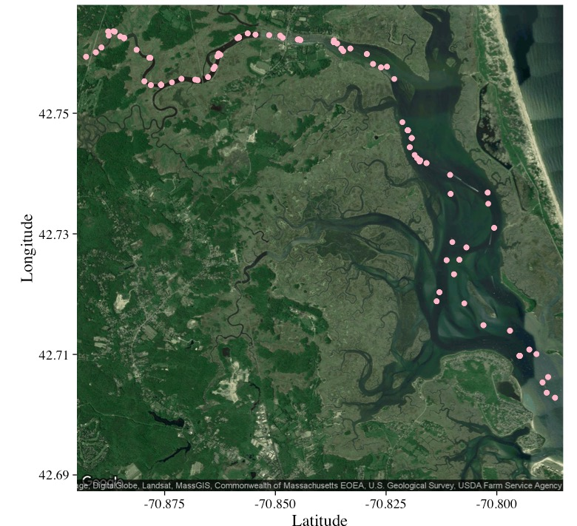
Combining Data Sources and Maps
Chlorophyll a
Abundance of taxonomic groups
Temperature
Salinity
Hopkinson and Hobbie 2012 http://ecosystems.mbl.edu/PIE/data/EST/EST-PR-ChemTax.html

Slide 34
Coordinate Systems Transform Relationships

Slide 35
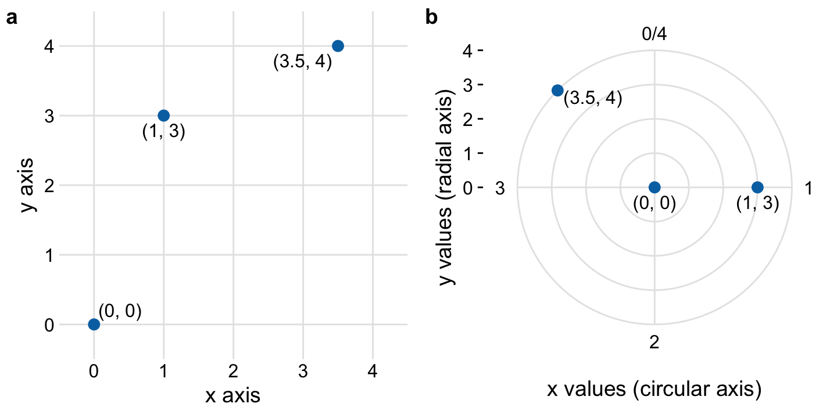
The Polar Coordinate System is Useful!
Wilke 2018

Slide 36
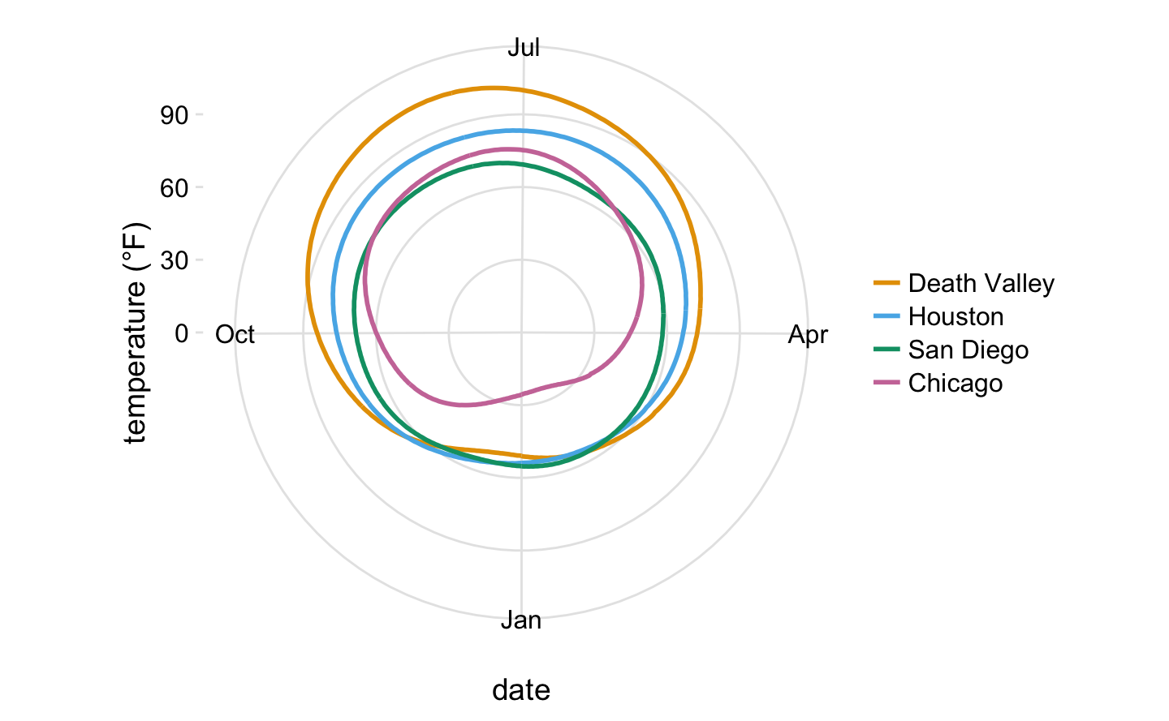
The Polar Coordinate System is Useful!
Wilke 2018

Slide 37
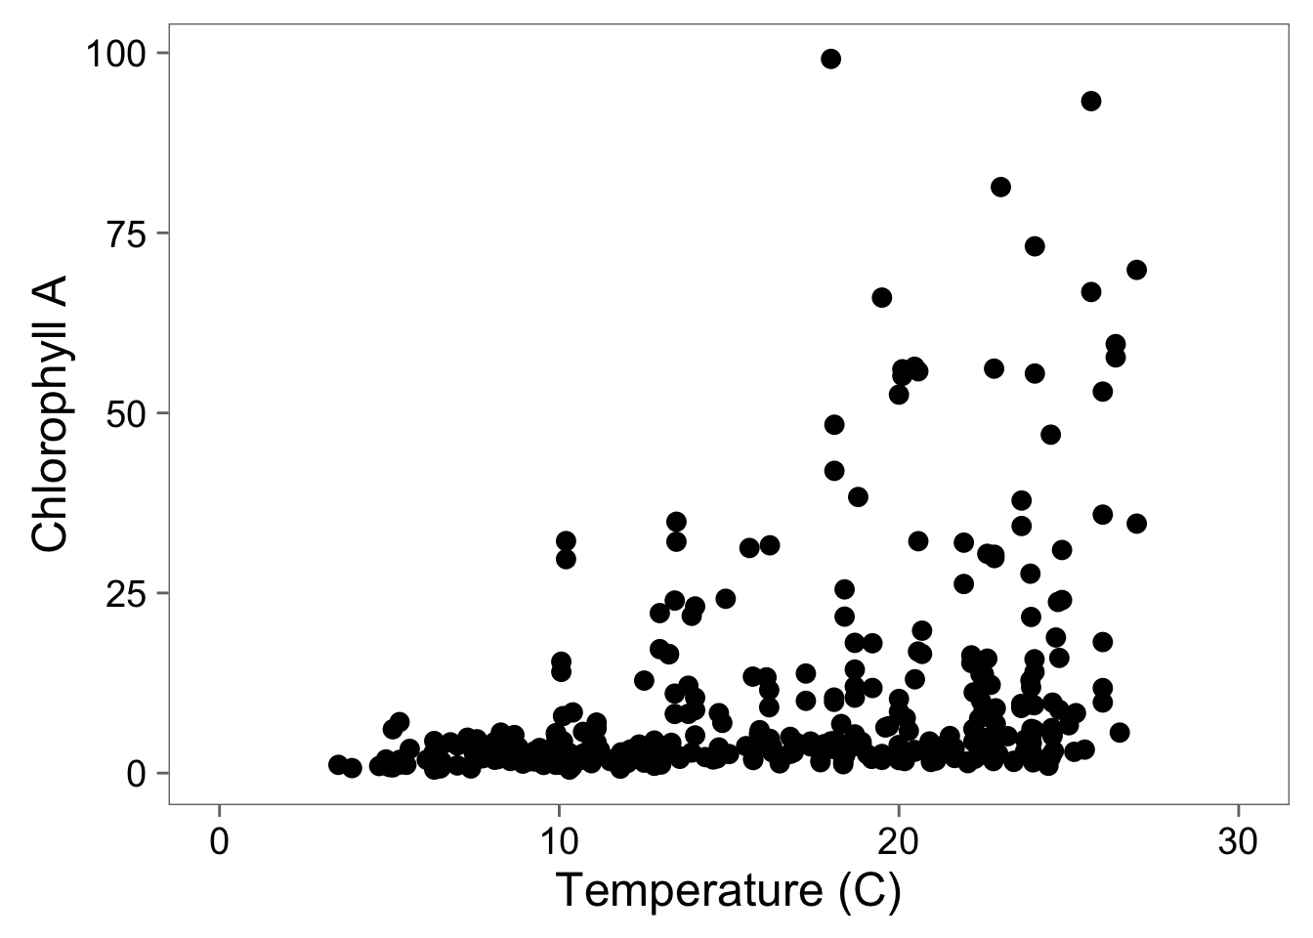
Adding Full Scale to 0

Slide 38
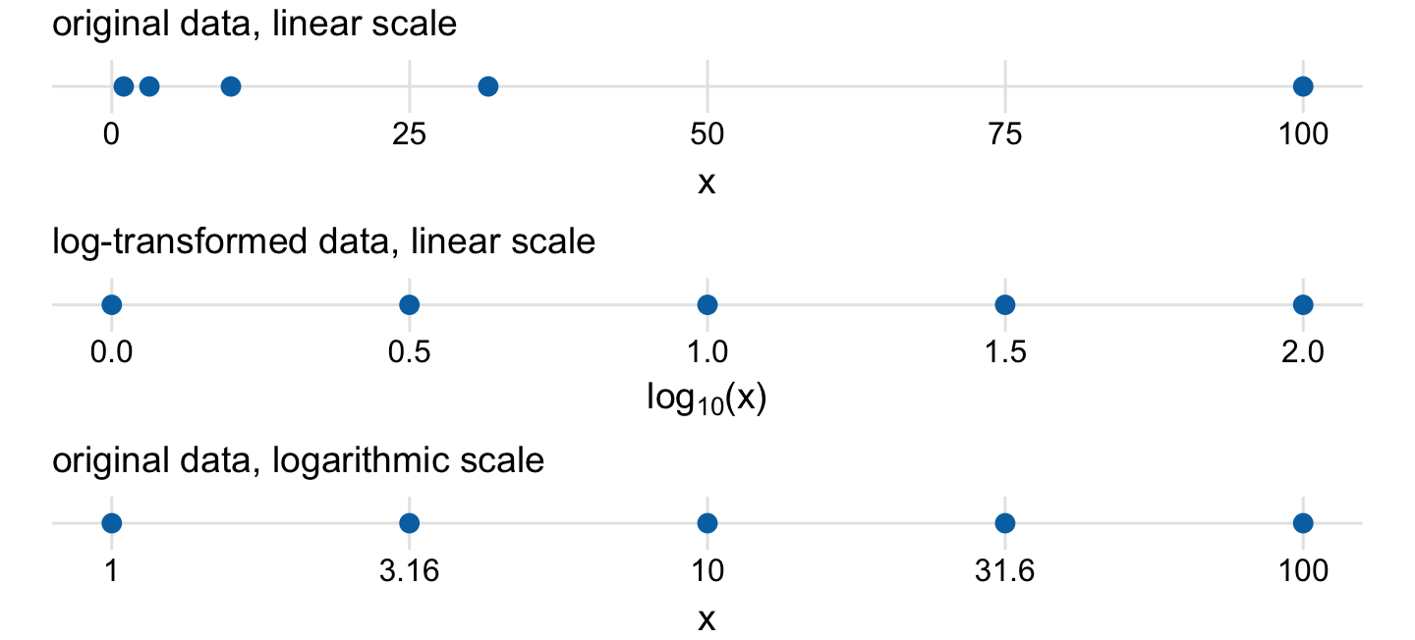
Why Transform?
Wilke 2018

Slide 39
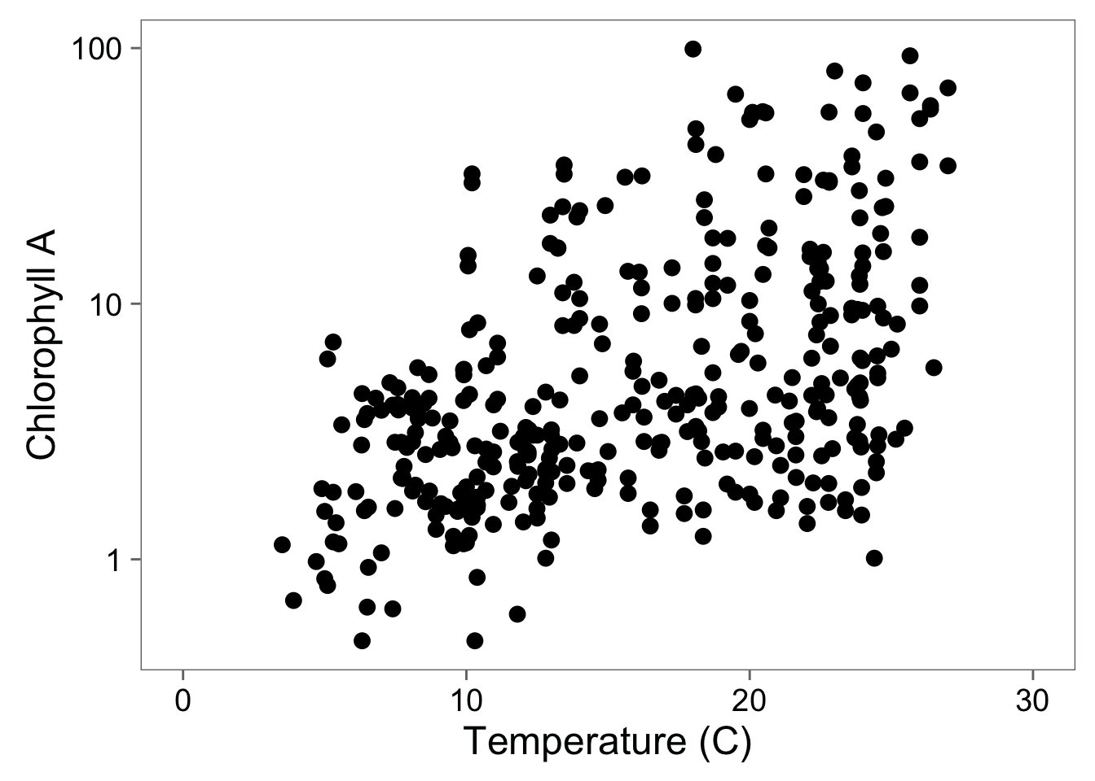
Log-Transformation To See Relationship

Slide 40
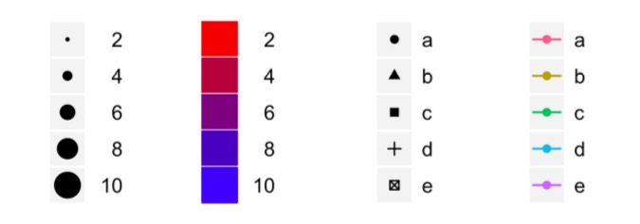
Scales to Add Dimensions of Data

Slide 41
Colors Can Distinguish Groups
Wilke 2018

Slide 42
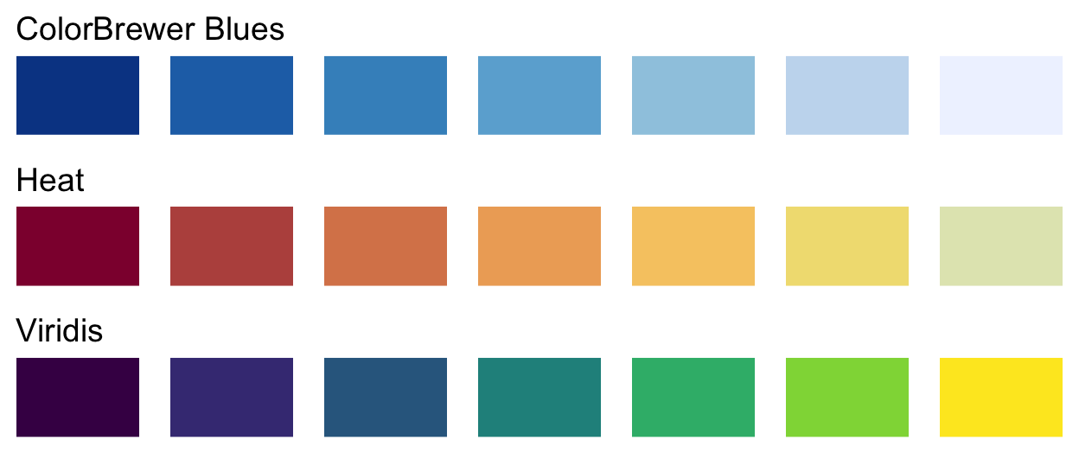
Colors Can Show Data
Wilke 2018

Slide 43
Beware Not Thinking About Color Blindness
Never use Red-Green!
Use redundant coding: shapes, sizes, etc.
Wilke 2018

Slide 44
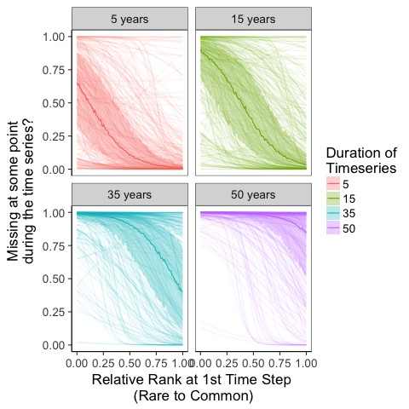
Redundant Coding

Slide 45
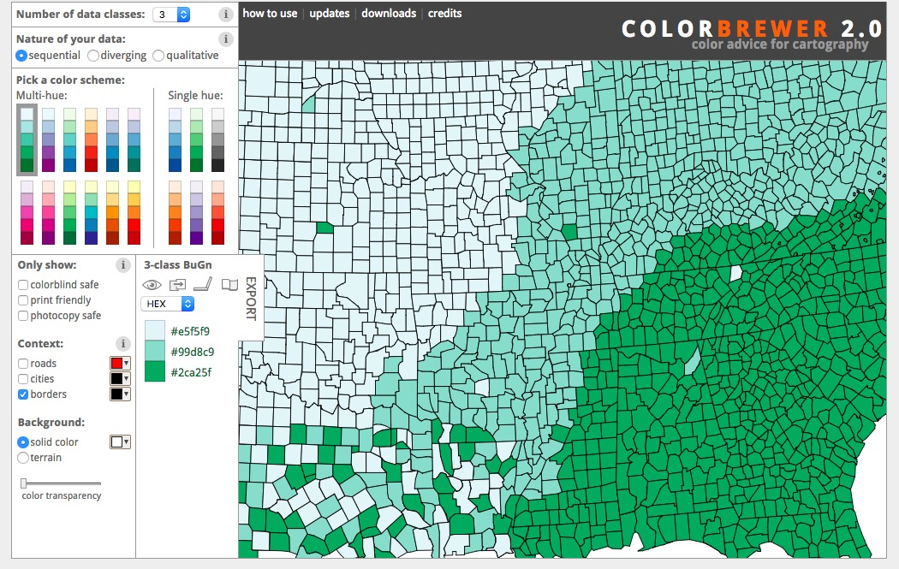
Colorbrewer.org
See also https://flowingdata.com/tag/color/

Slide 46
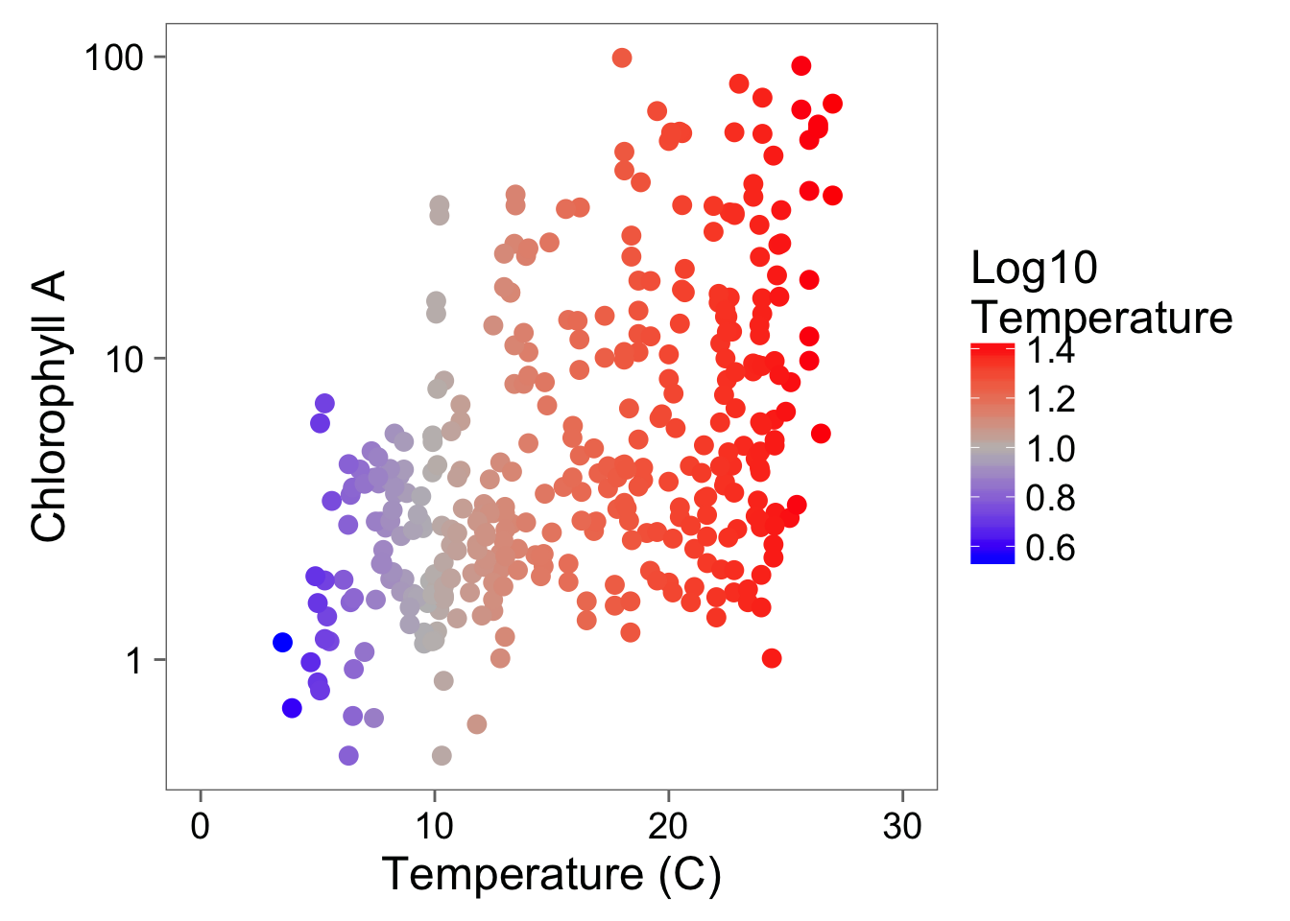
A Touch of Color!

Slide 47
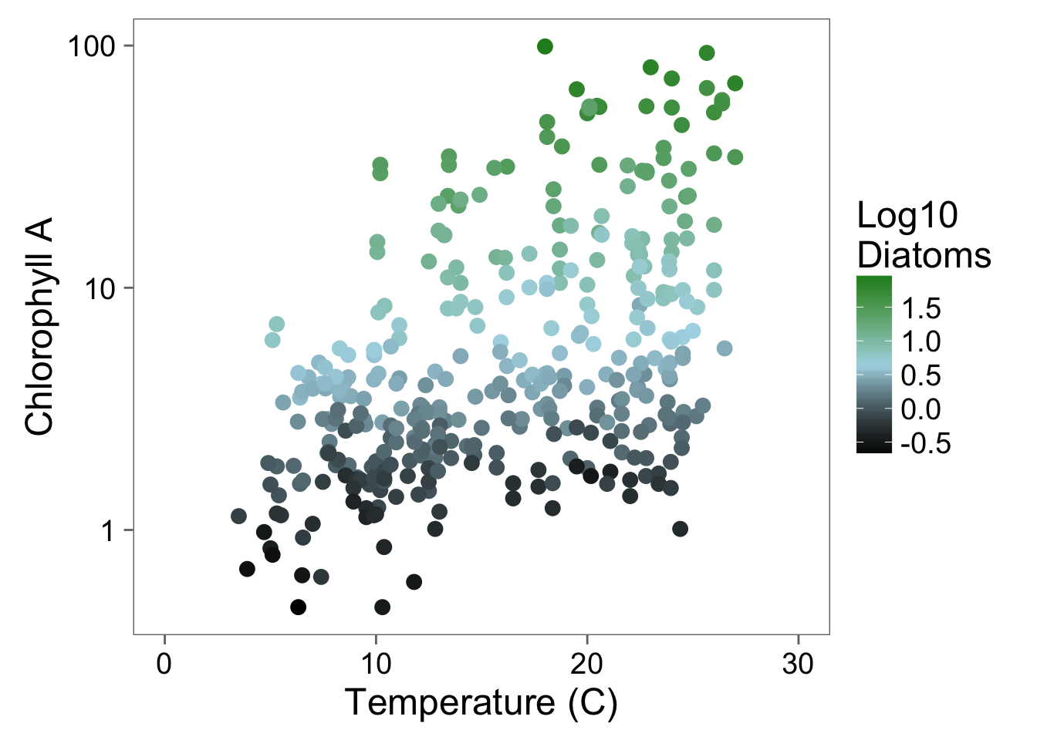
Color Can Bring in Another Dimension

Slide 48
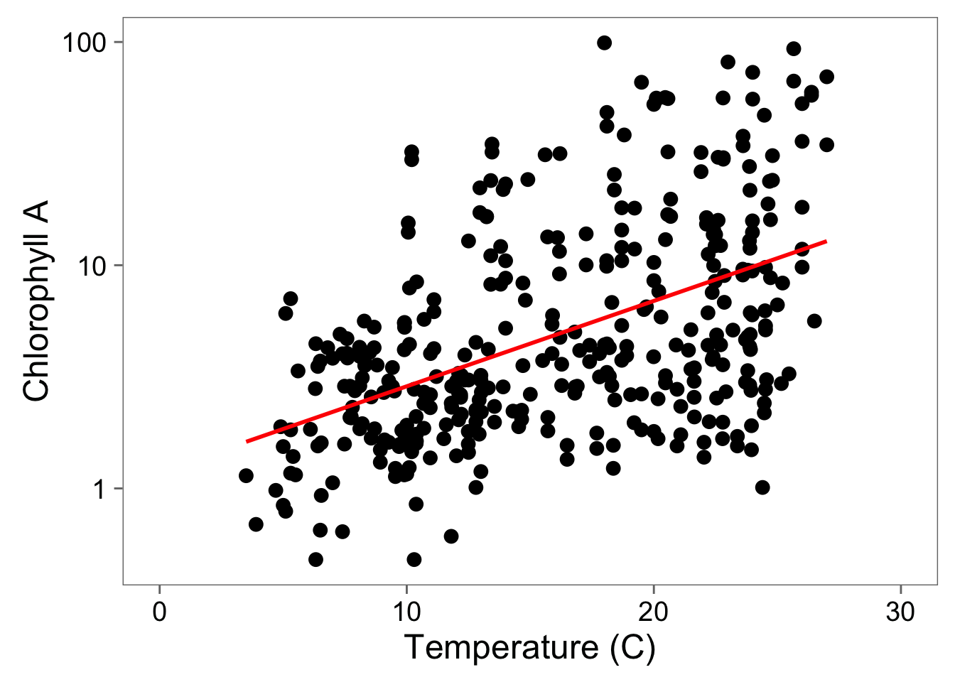
Statistical Fit to Aid Understanding

Slide 49
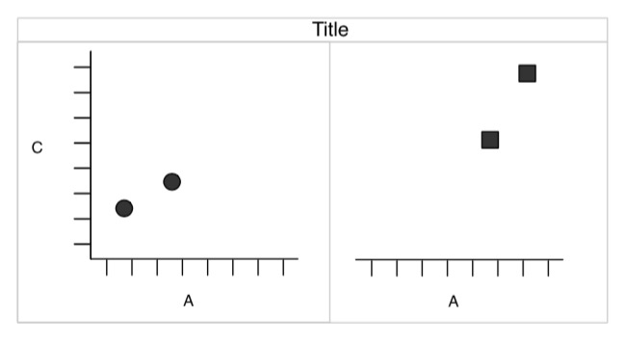
Facets to Add Fine-Grained Information or New Dimensions

Slide 50
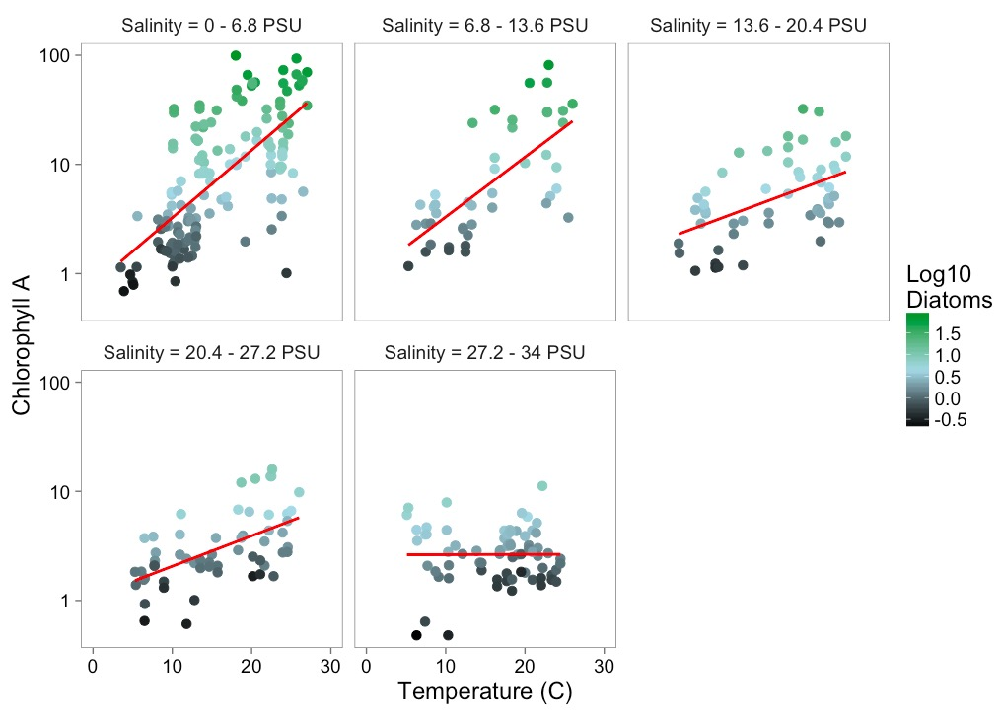
Facets Add Information

Slide 51
Data Viz in a Nutshell
History
Graphical Basics
Minimalist principles

Slide 52
Minimalist Presentation
Above all else show data.
2. Maximize the data-ink ratio
3. Erase non-data-ink.
4. Erase redundant data-ink.
Tufte 2002

Slide 53
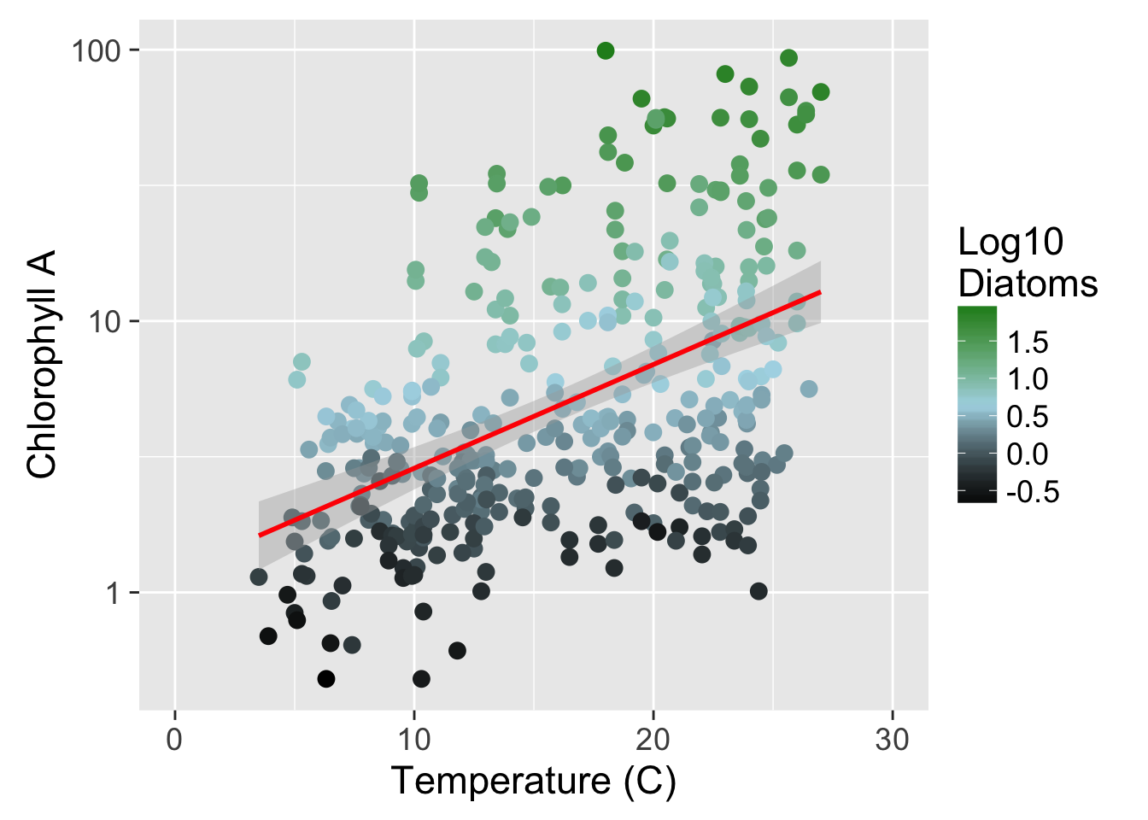
Show the Data

Slide 54
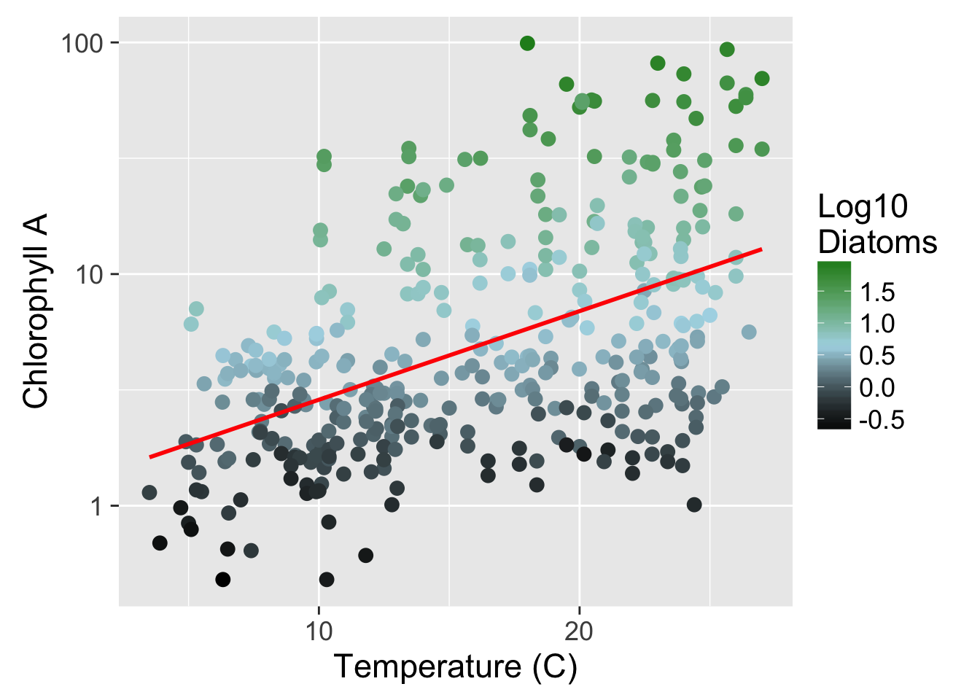

Slide 55
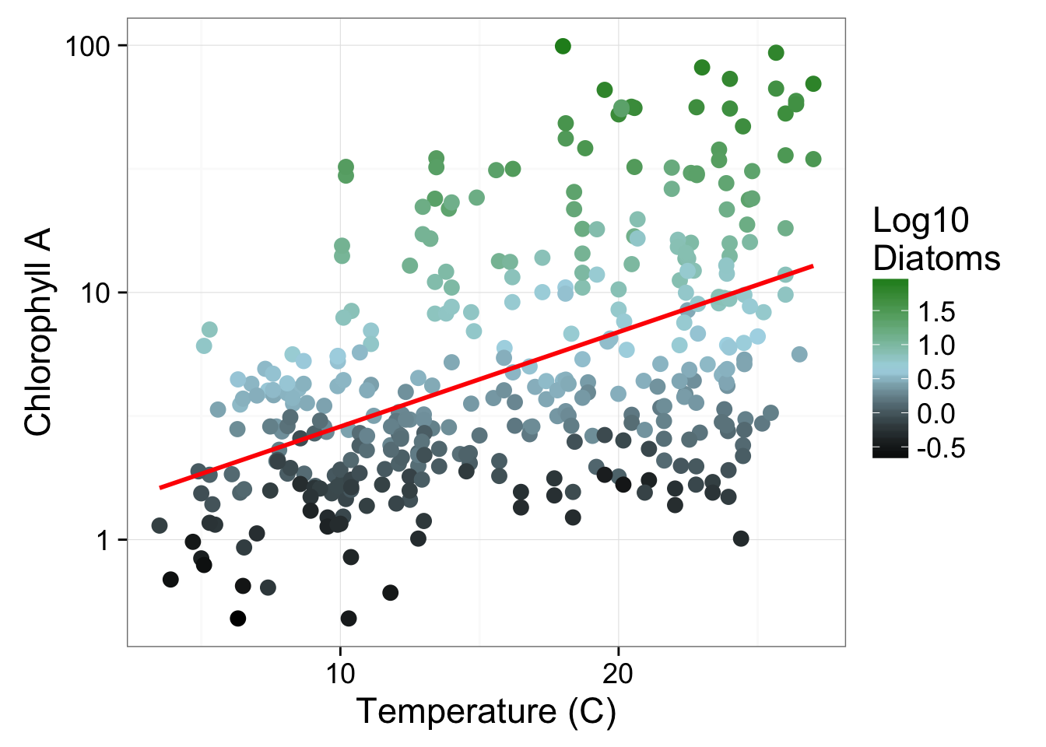

Slide 57
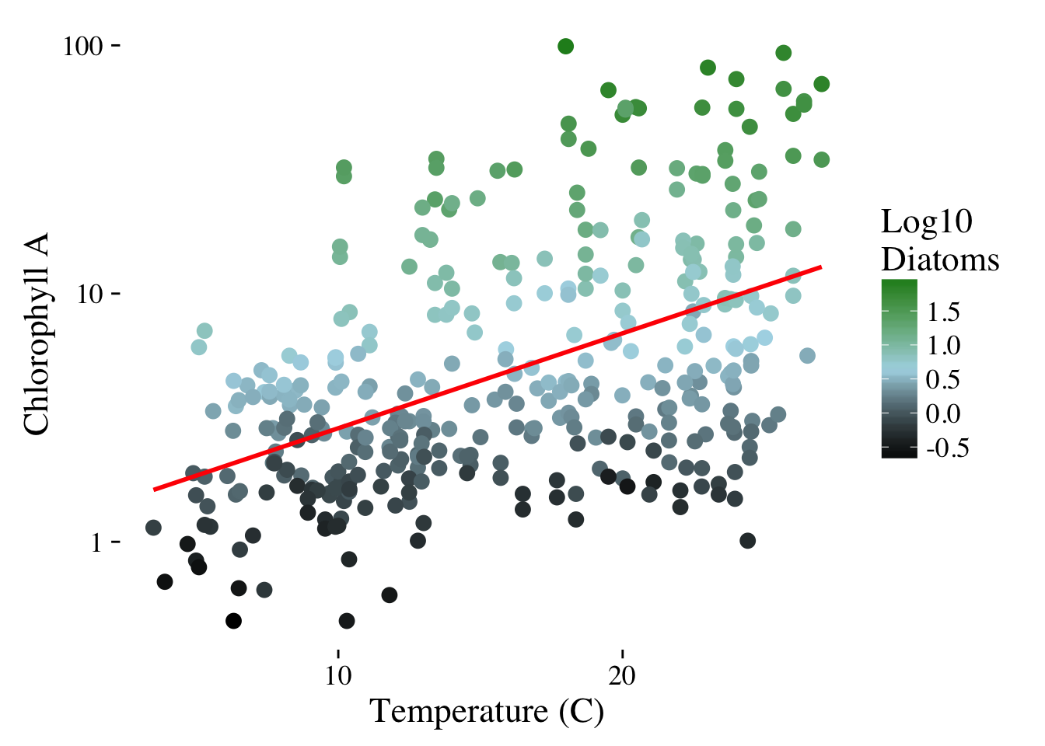

Slide 58
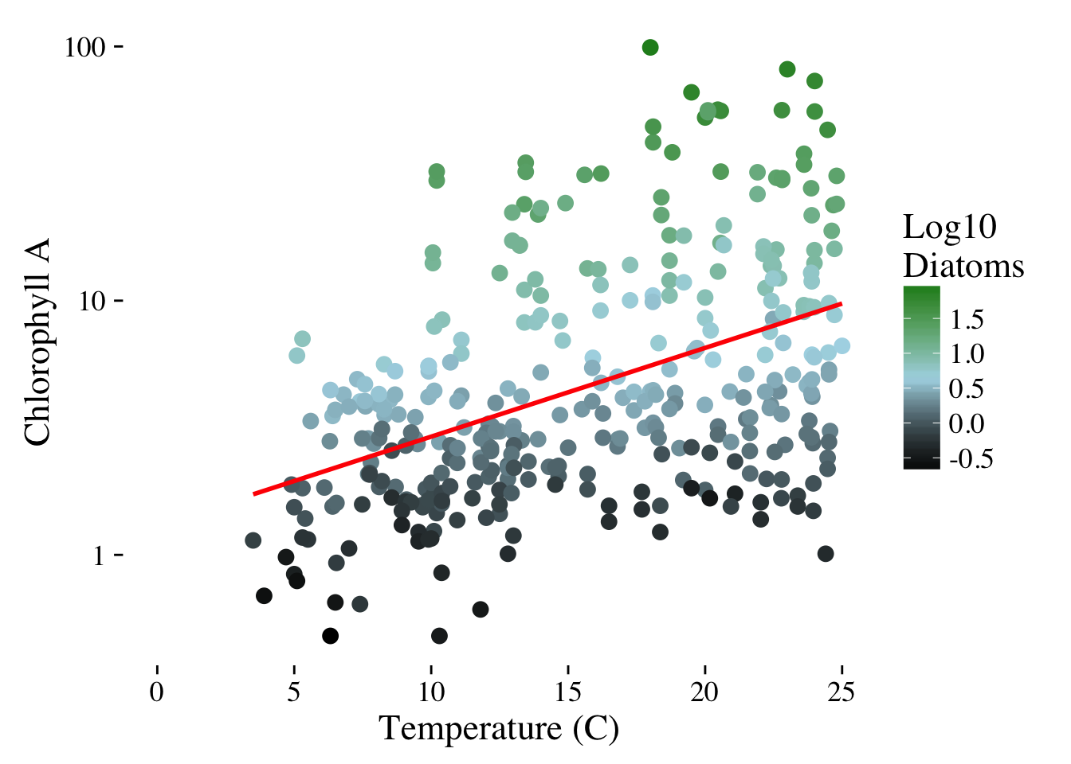
Notes:
Thoughts here?

