Slide 1
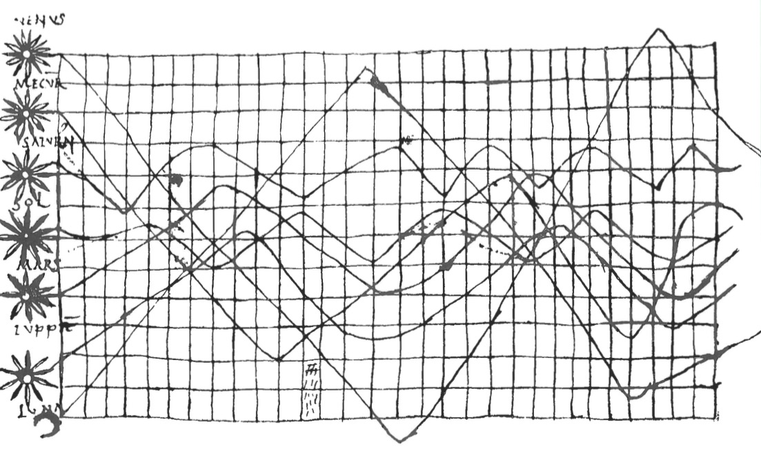
Data Visualization

Slide 2
Data visualization is Communication

Slide 3
Principles of Graphical Excellence
Clarity
Precision
Efficiency
Maximize ideas, minimize ink
(from Tufte)

Slide 4
Data Viz in a Nutshell
History
Graphical Basics
Minimalist principles
Notes:
It is common to think of statistical graphics and data visualization as relatively mod- ern developments in statistics. In fact, the graphic representation of quantitative in- formation has deep roots.

Slide 5
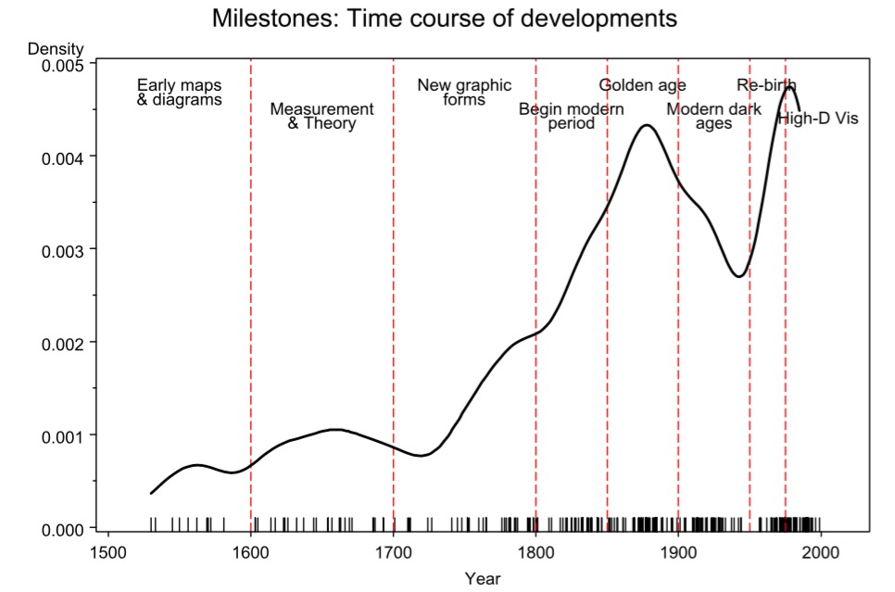
Friendly 2008
Notes:
From the Milestones project

Slide 6
Data Viz in the 10th Century
From Funkhouser 1936
Notes:
10th century
What do you see here. What works. What does not?
Planetary movements shown as cyclic inclinations over time, by an unknown astronomer, appearing in a th-century appendix to commentaries by A.T. Macrobius on Cicero’s In Somnium Sciponis. Source: Funkhouser (, p. )

Slide 7
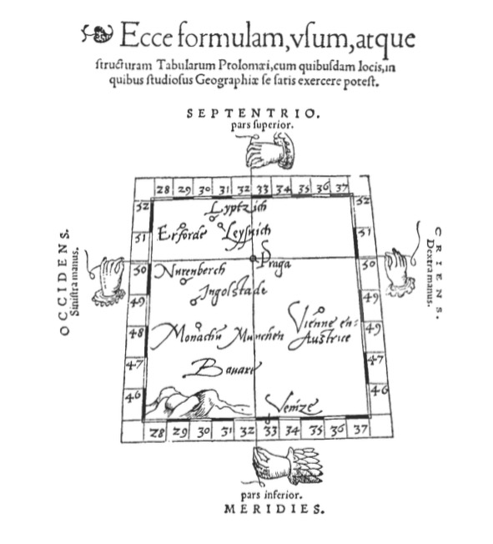
Notes:
Early maps. Little information beyond intersections – 1546 from Pedrus Apenius
What do you get from this?

Slide 8
Maps and Measurement Theory
Langren 1644
Notes:
Langren’s  graph of determinations of the distance, in longitude, from Toledo to Rome. e correct distance is  ′. Source: Tu e (, p. )

Slide 9
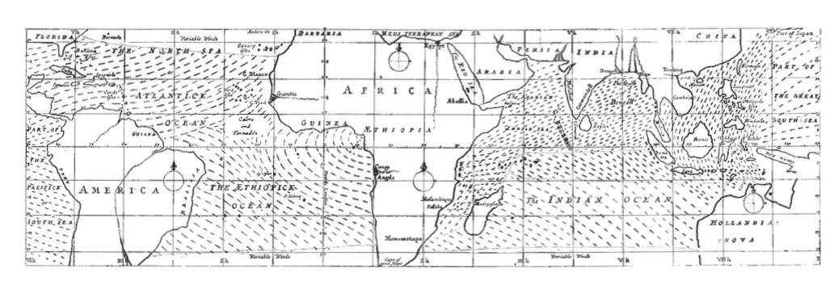
Maps as Rich Information Source
Notes:
Edmond Halley 1686

Slide 10
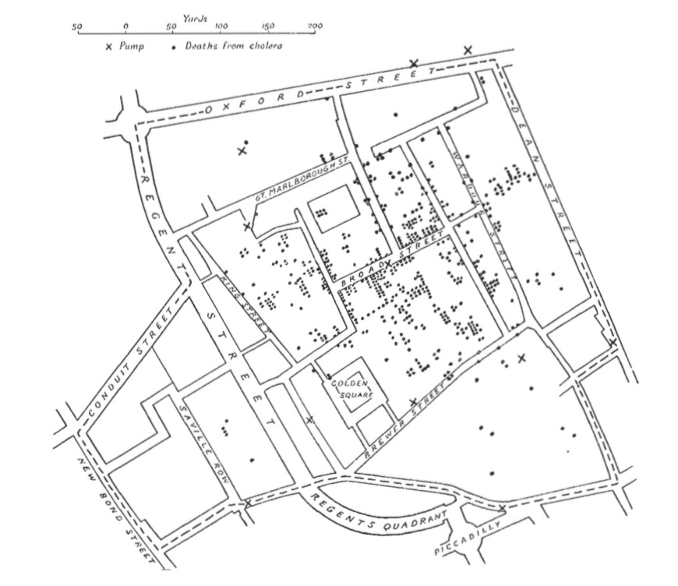
Spatial Patterns Intuitive
Cholera in London
John Snow 1855
Notes:
How would you make this abstract?
In October 1831, the first case of asiatic cholera occurred in Great Britain, and over 52Kpeople died in the epidemic that ensued over the next  months or so (Gilbert, ). Subsequent cholera epidemics in – and – produced similarly large death tolls, but the water-borne cause of the disease was unknown until  when Dr John Snow produced his famous dot map
It’s not all maps – timeseries, particularly as govs started getting into data

Slide 11
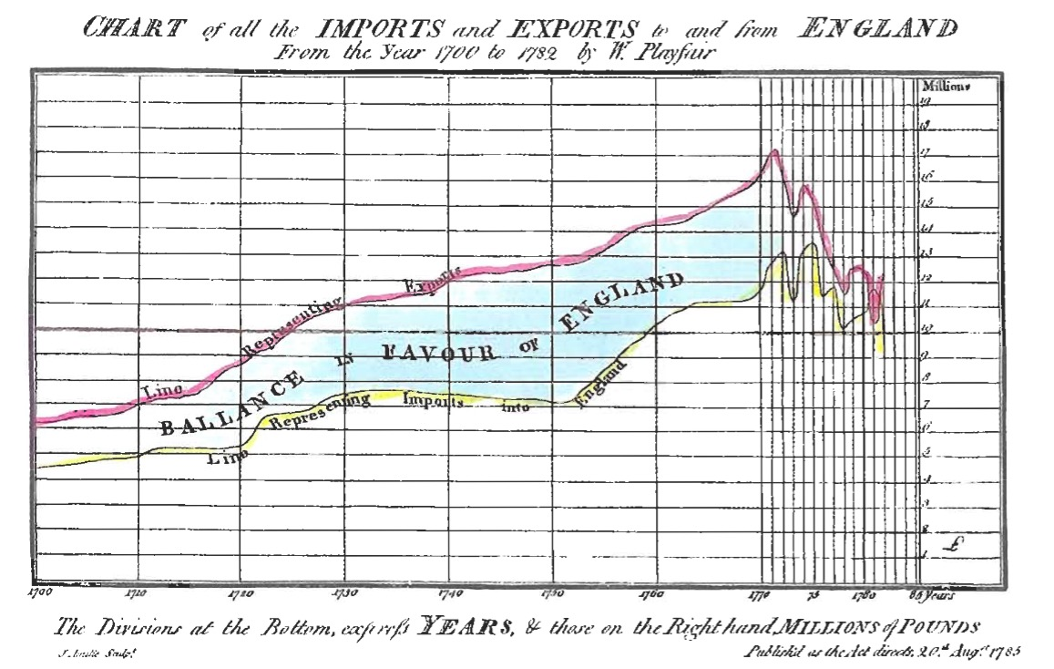
Playfair 1873
Notes:
Playfair! A father of modern statistical graphics

Slide 12
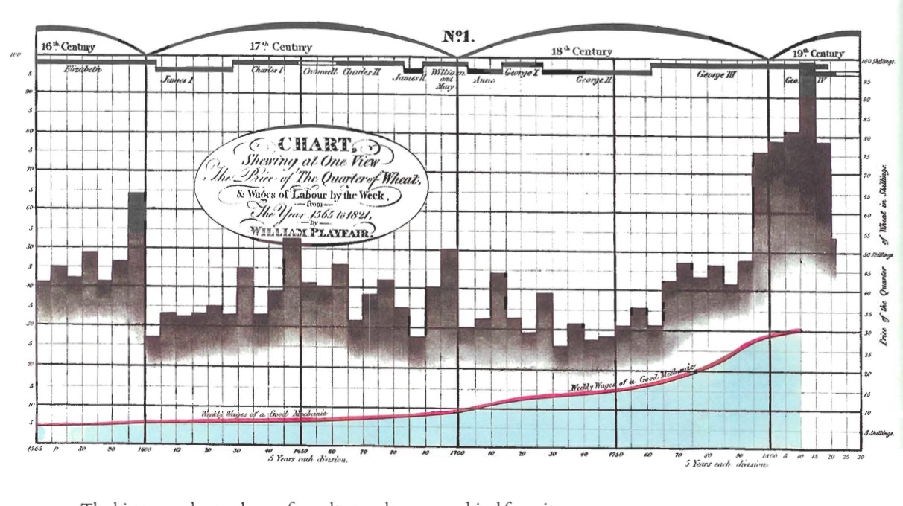
Multiple Data Sources to Make a Point
Price of Wheat
Wages
Notes:
What do you notice? What is hard to pick out?

Slide 13
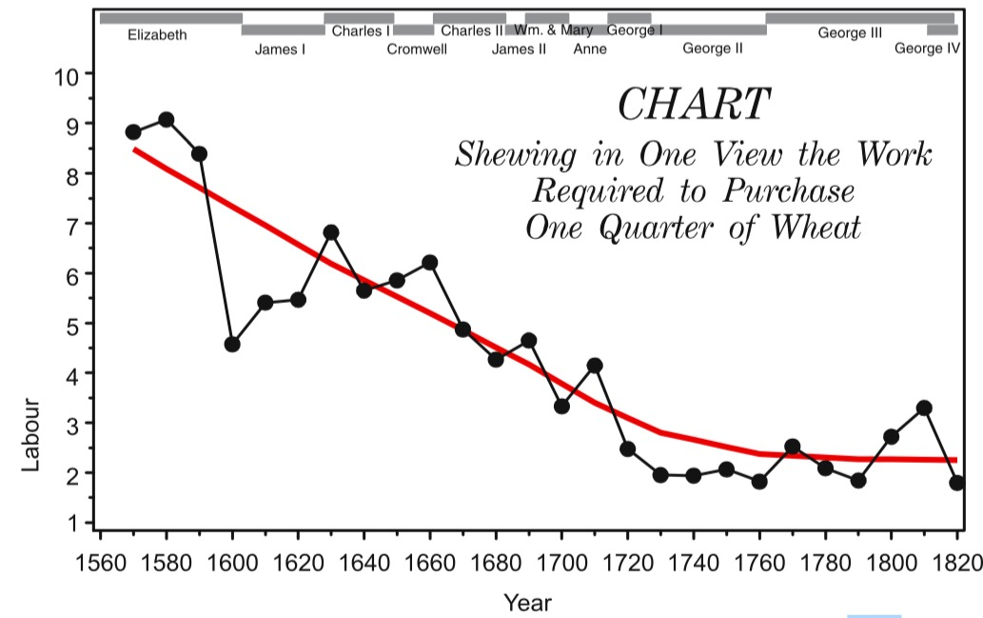
Showing Relationships Helps Comprehension
Friendly 2008

Slide 14
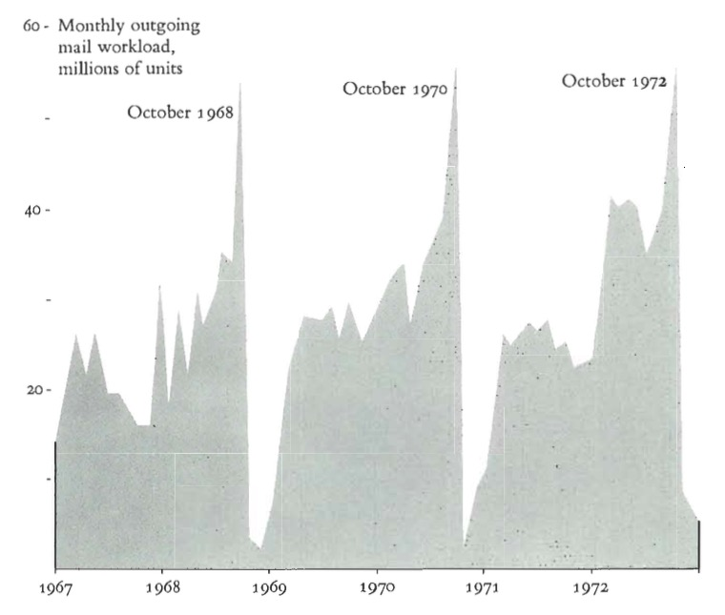
Sometimes One Variable is Enough

Slide 15
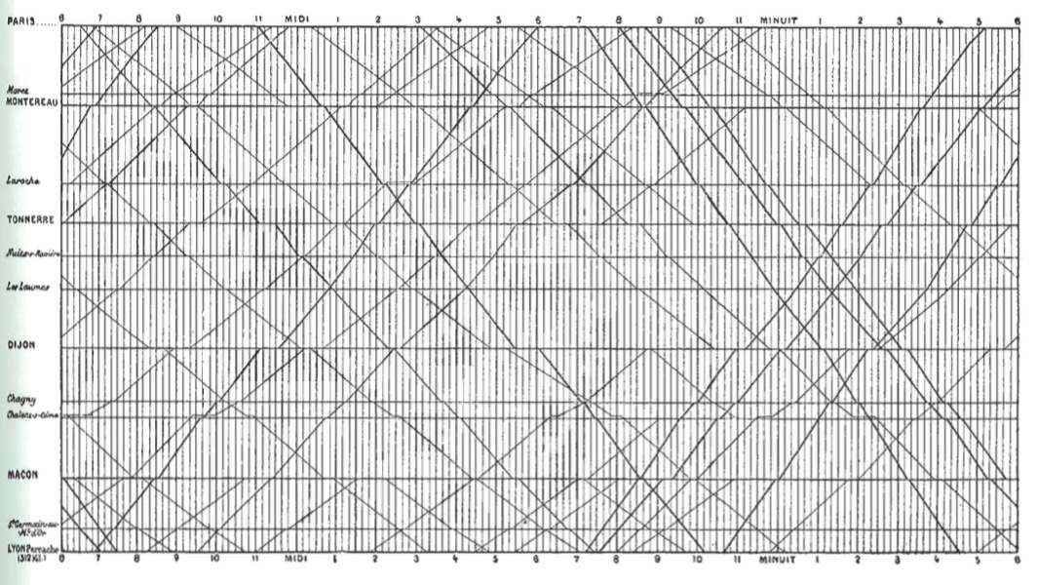
Adding Space to Time
Notes:
Marey’s train graph
What works, what doesn’t?

Slide 16
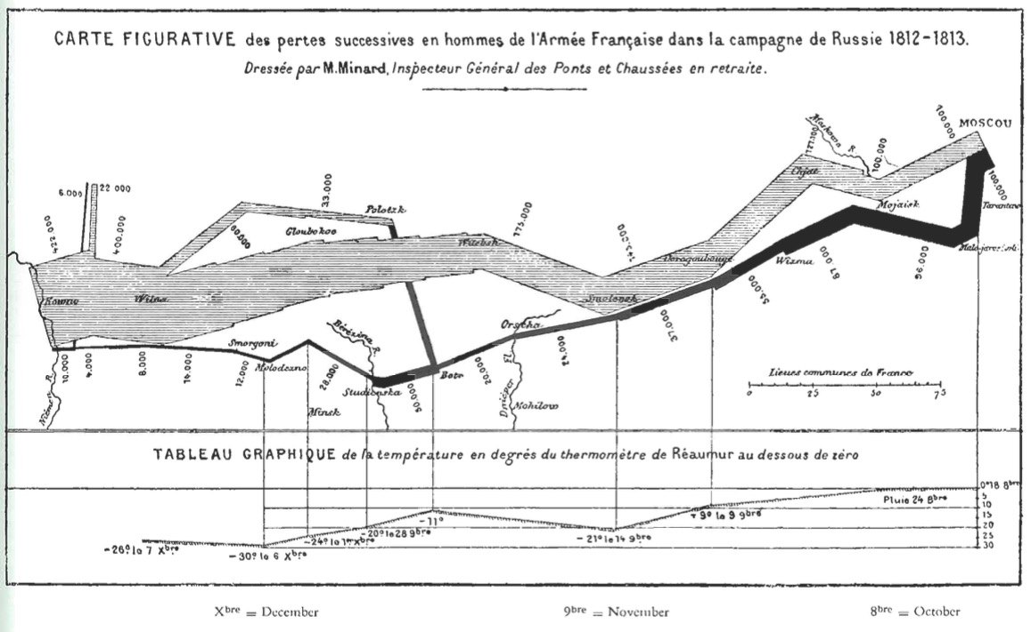
Unifying Maps and Timeseries

Slide 17
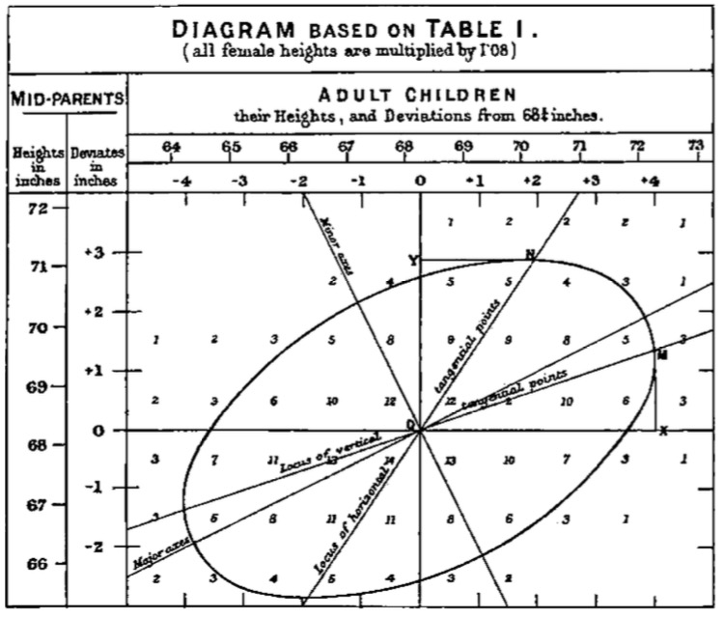
Understanding Relationships
Galton 1886
Notes:
Galton’s smoothed correlation diagram for the data on heights of parents and children, showing one ellipse of equal frequency.

Slide 18
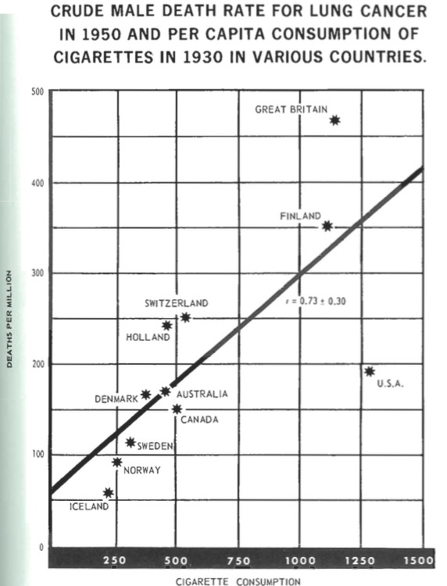
Notes:
Abstract & Statistical Information
1955 Surgeon General’s Report

Slide 19
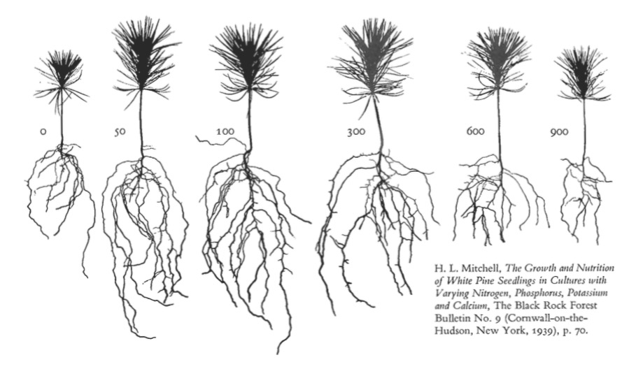
Abstraction Can Tell Wonderful Stories

Slide 20
Data Viz in a Nutshell
History
Graphical Basics
Minimalist principles

Slide 21
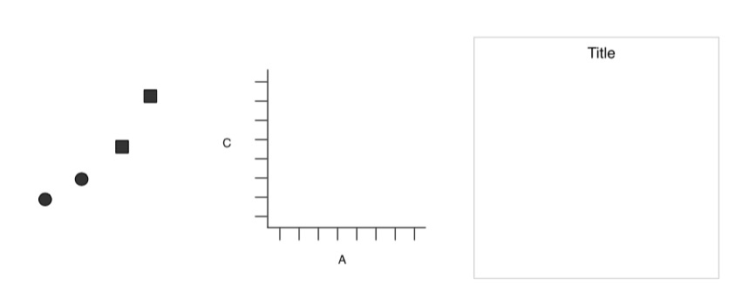
Elements of a Plot
Geometric Objects
Scales & Coordinates
Annotations
Wickham 2010

Slide 22
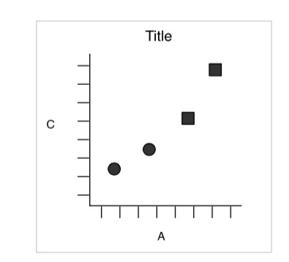
Elements of a Plot
Wickham 2010
Notes:
Axes for scale
Points and their properties
Identifying text

Slide 23
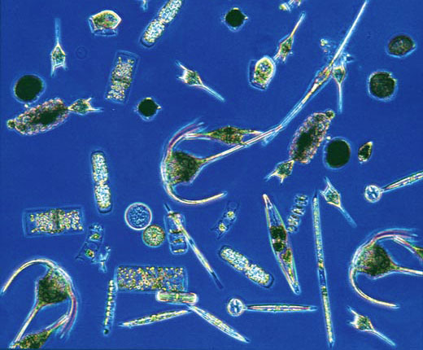
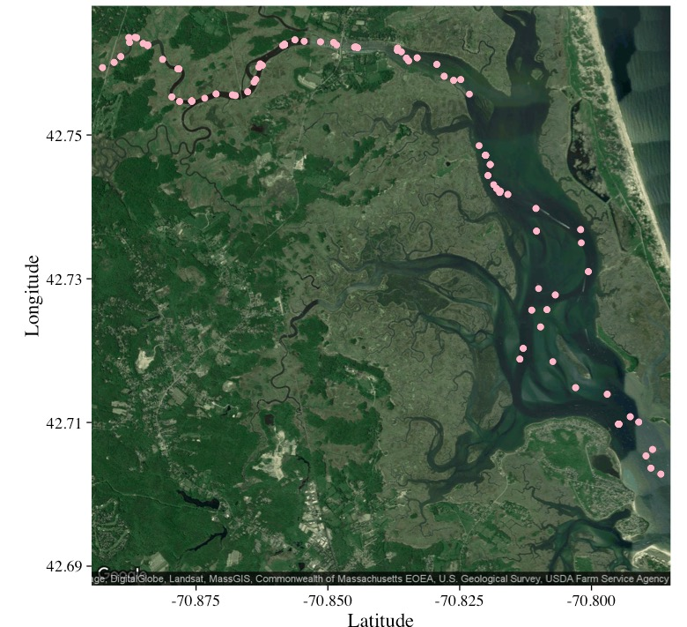
Plankton Data from Plum Island
Chlorophyll a
Abundance of taxonomic groups
Temperature
Salinity
Hopkinson and Hobbie 2012 http://ecosystems.mbl.edu/PIE/data/EST/EST-PR-ChemTax.html

Slide 24
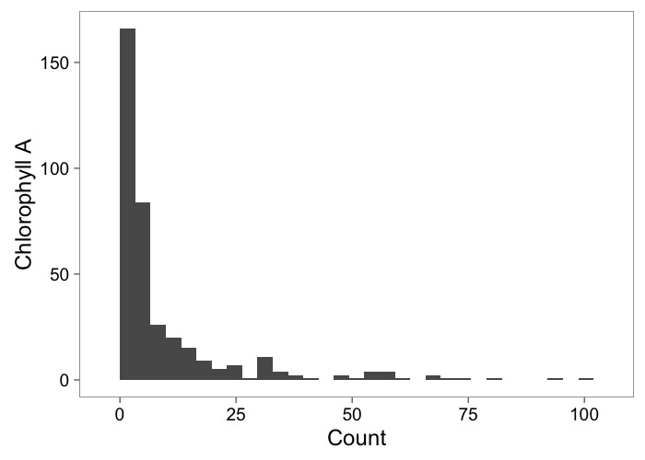
Histograms Show Frequency

Slide 25
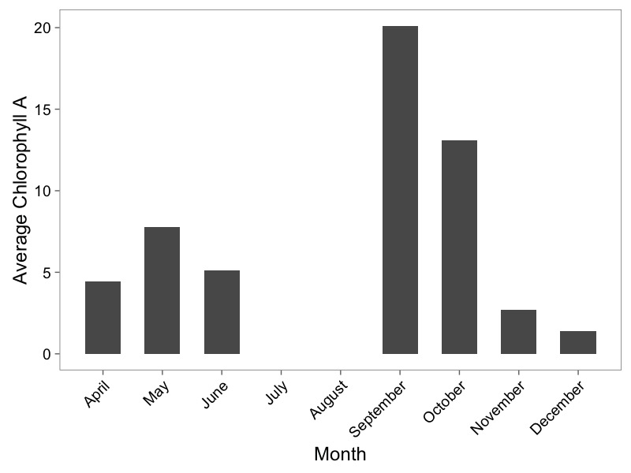
Barplots for Summarized Data

Slide 26
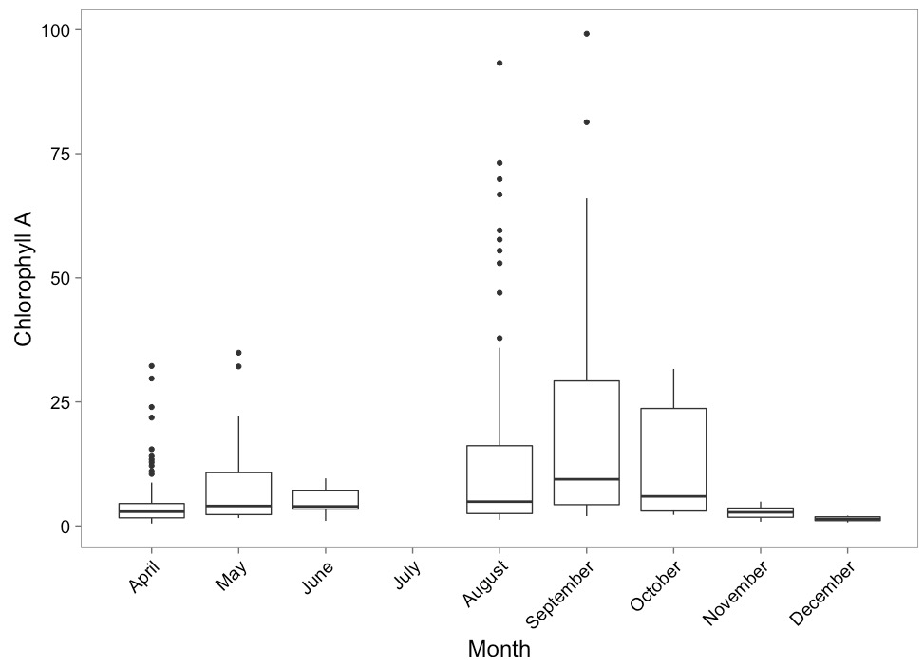
Boxplots to Show Variation

Slide 27
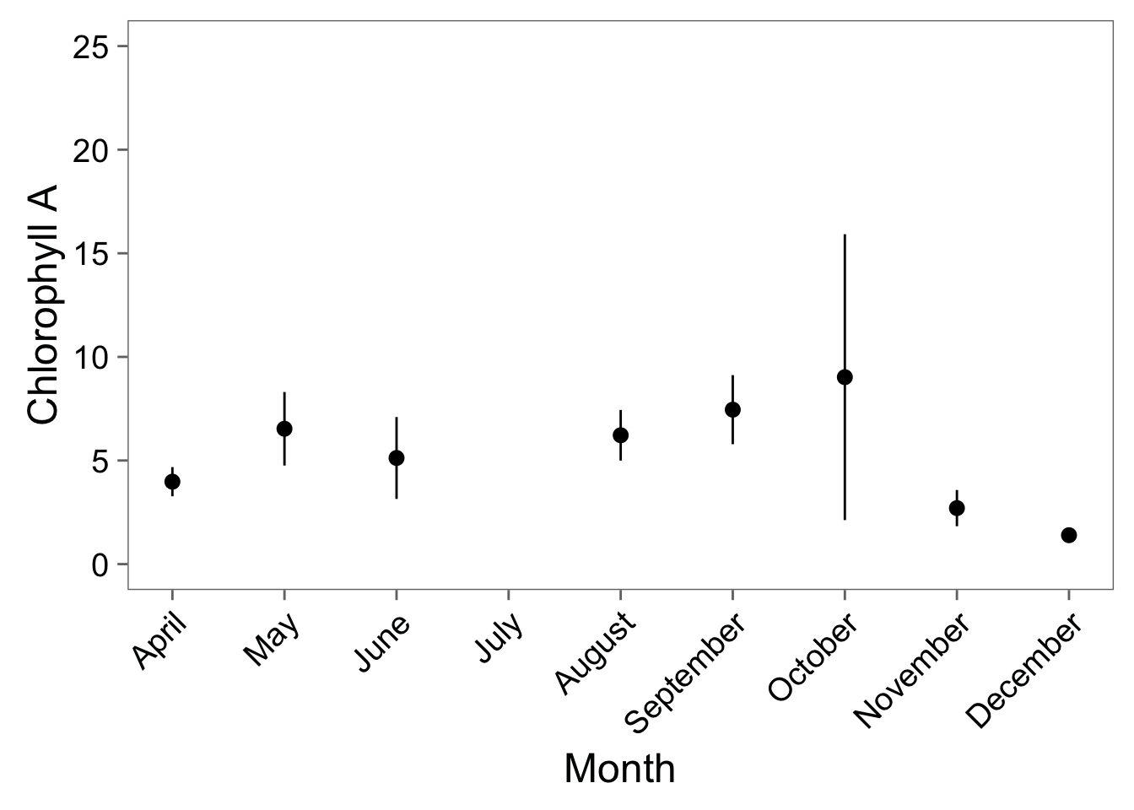
…Or Point-Ranges

Slide 28
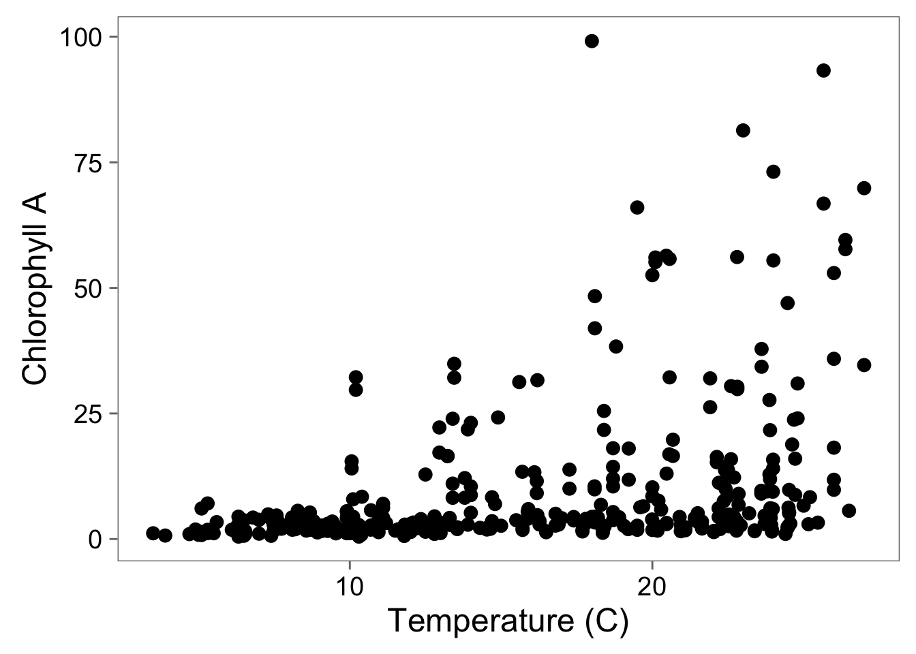
Scatterplots Show Relationships

Slide 29
Coordinate Systems Transform Relationships

Slide 30
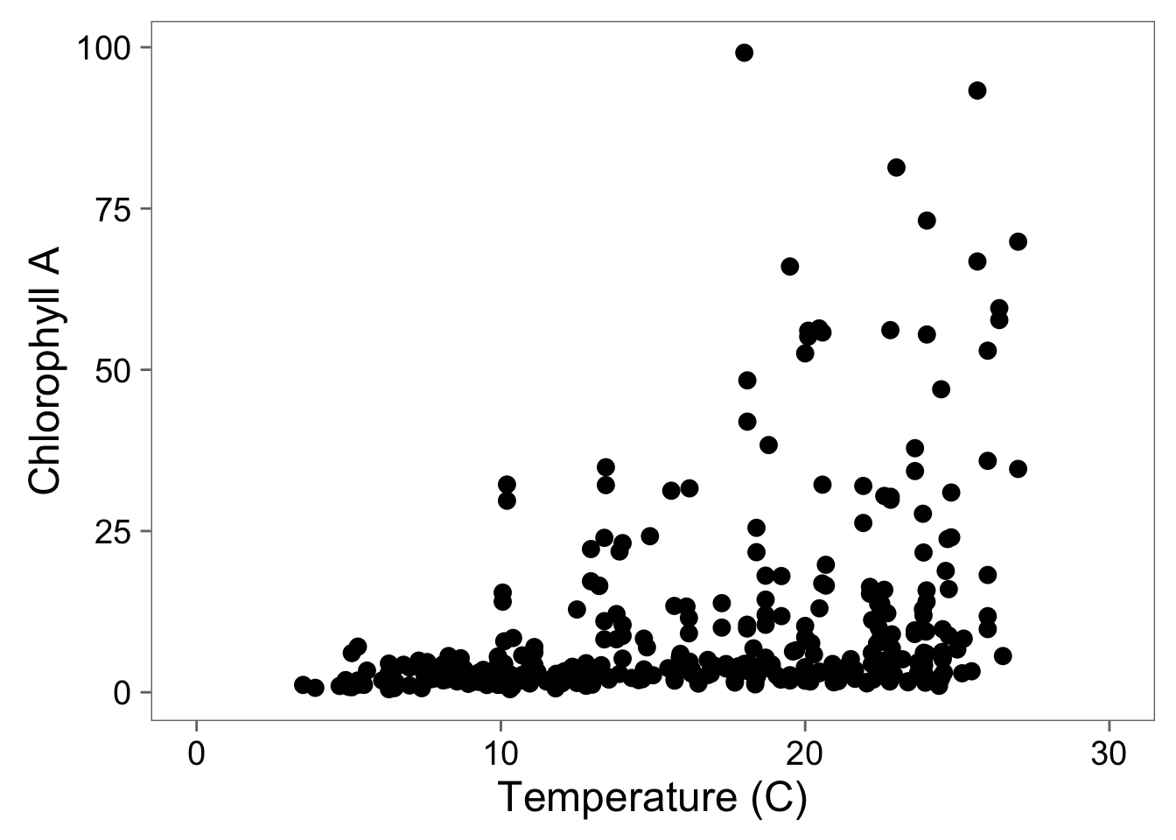
Adding Full Scale to 0

Slide 31
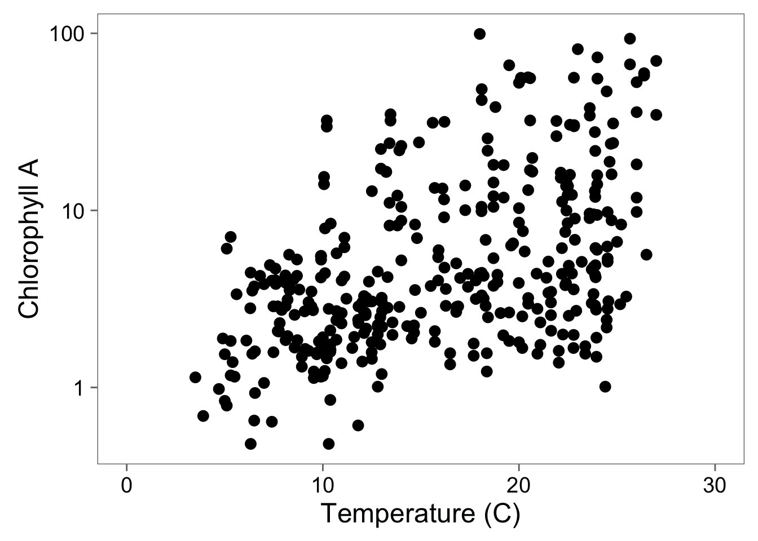
Log-Transformation To See Relationship

Slide 32
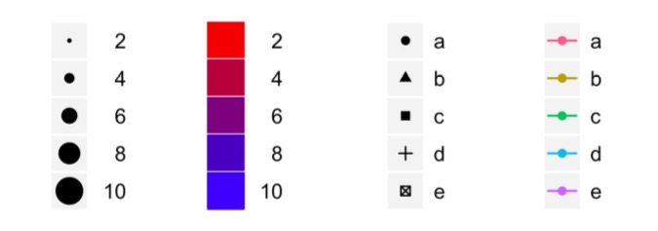
Scales to Add Dimensions of Data

Slide 33
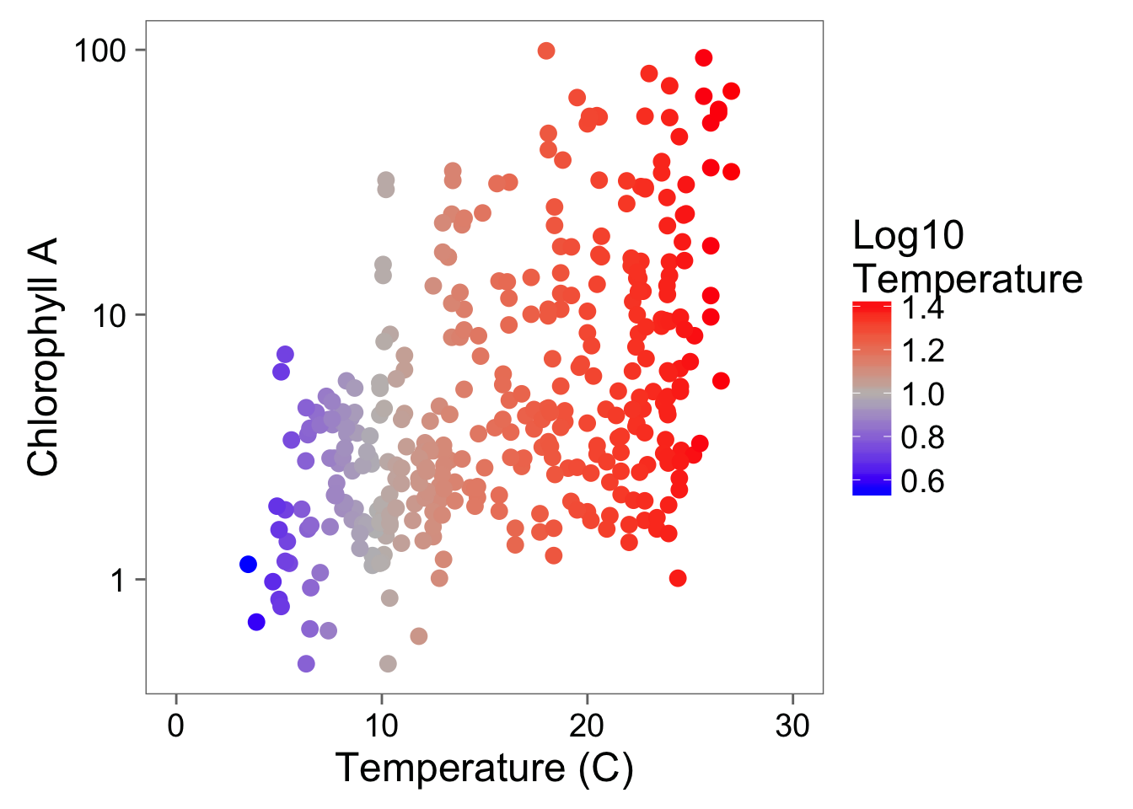
A Touch of Color!

Slide 34
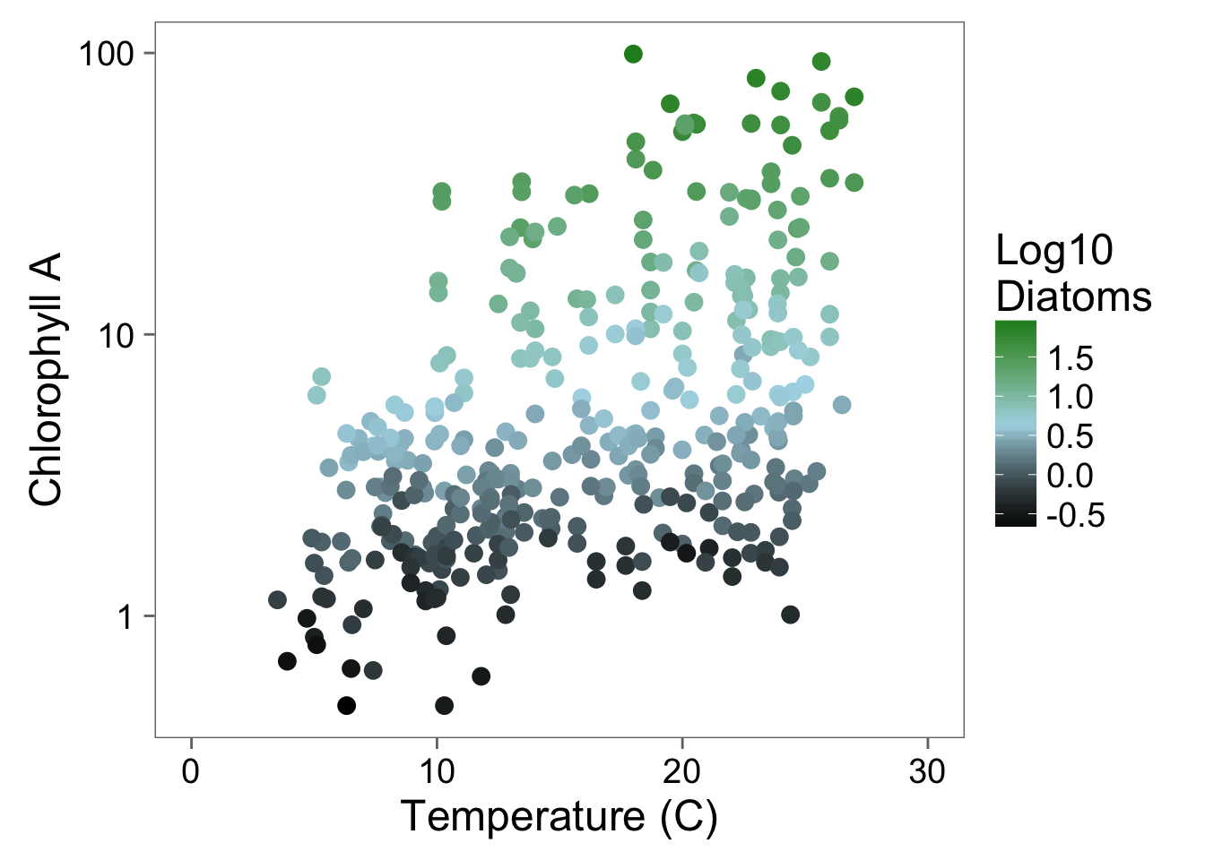
Color Can Bring in Another Dimension

Slide 35
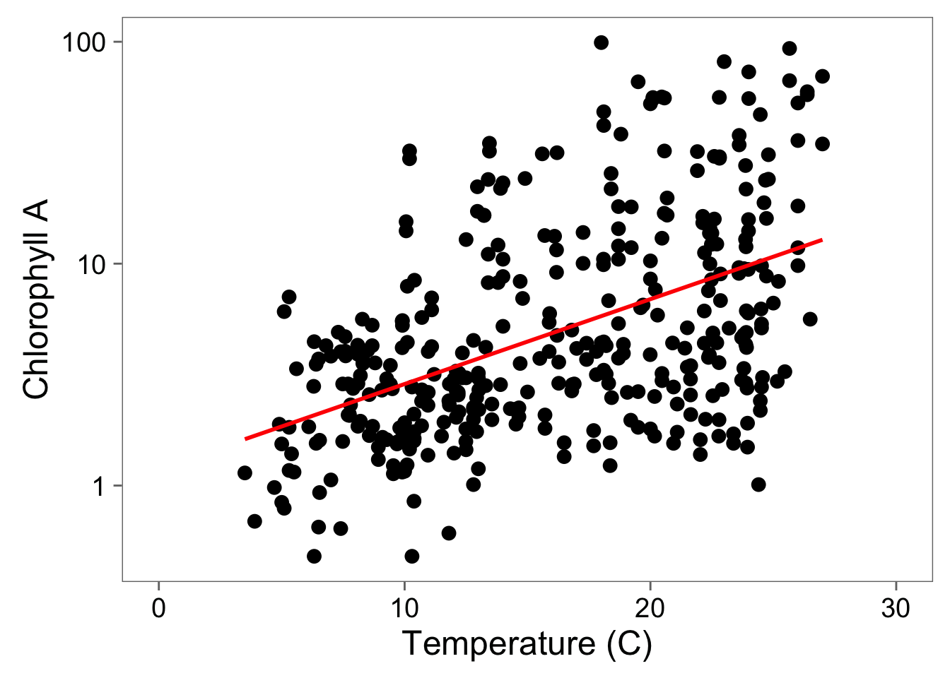
Statistical Fit to Aid Understanding

Slide 36
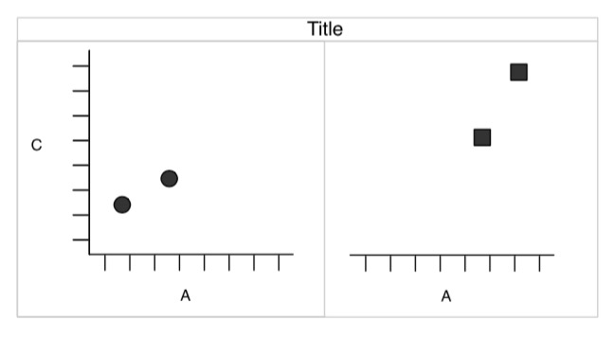
Facets to Add Fine-Grained Information or New Dimensions

Slide 37
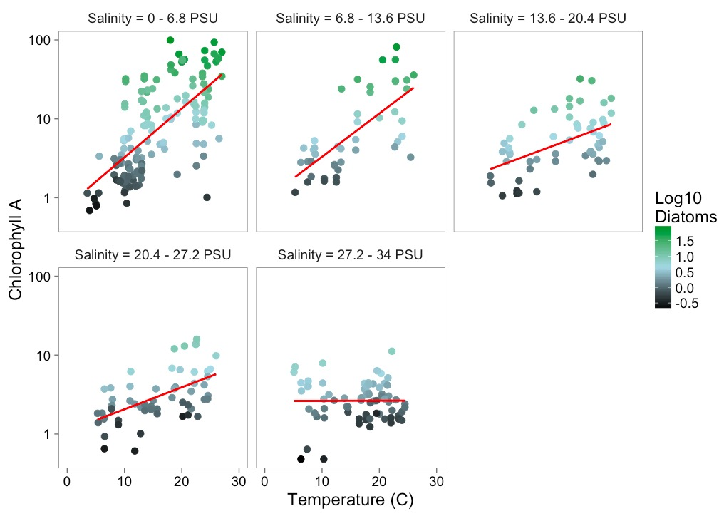
Facets Add Information

Slide 38
Data Viz in a Nutshell
History
Graphical Basics
Minimalist principles

Slide 39
Minimalist Presentation
Above all else show data.
2. Maximize the data-ink ratio
3. Erase non-data-ink.
4. Erase redundant data-ink.
Tufte 2002

Slide 40
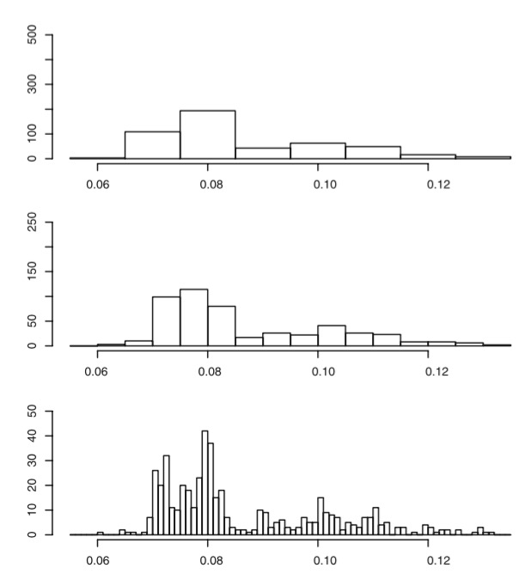
Which scale conveys the most information with the least ink?
Unwin 2008

Slide 41
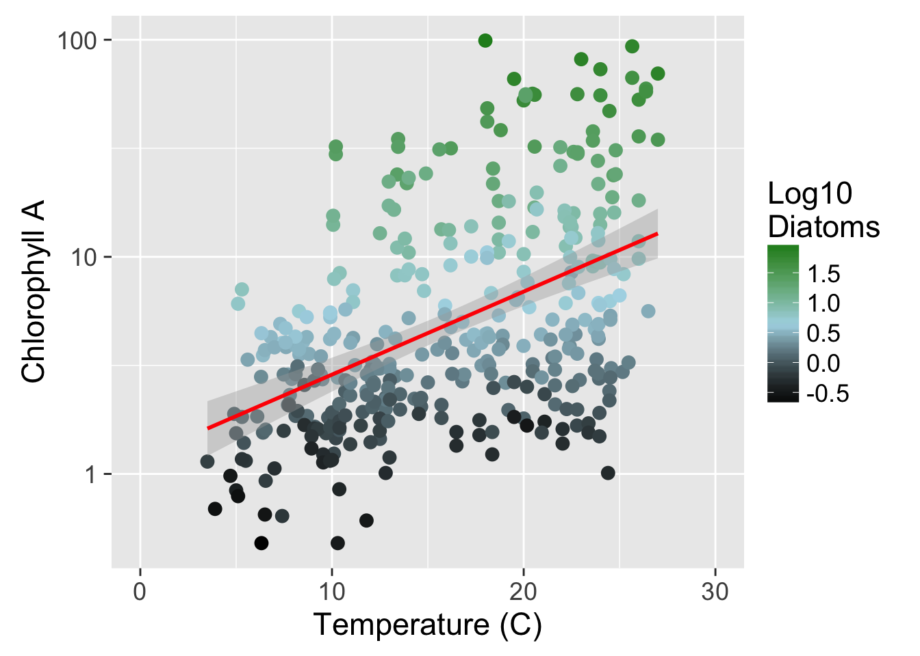
Show the Data

Slide 42
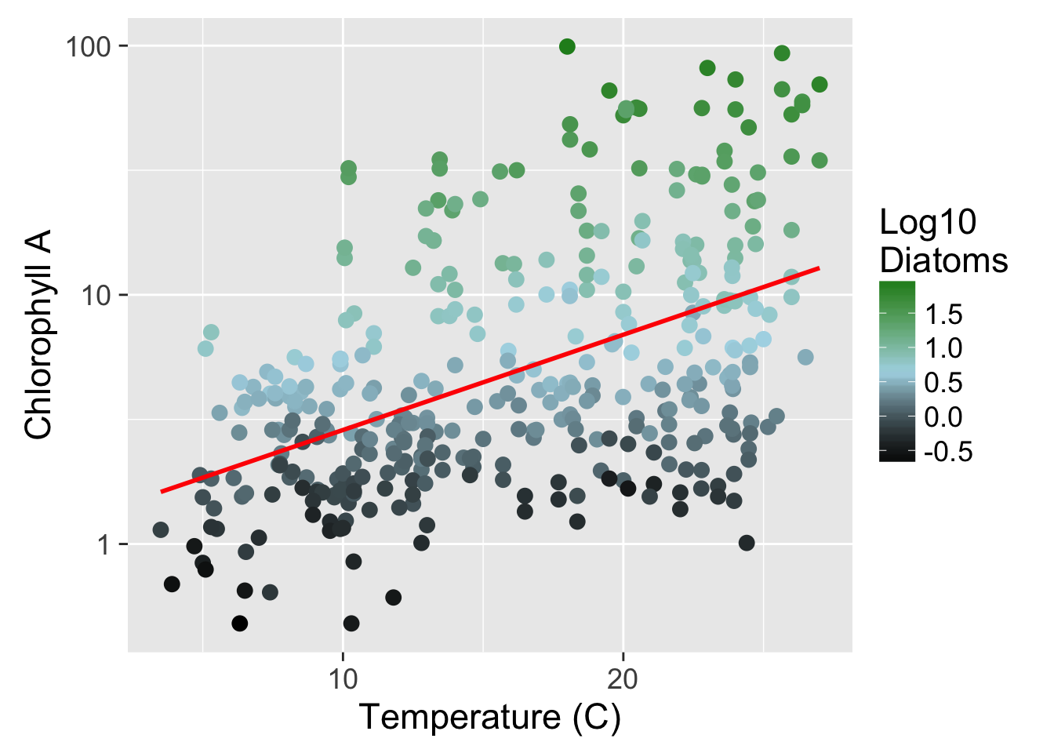

Slide 43
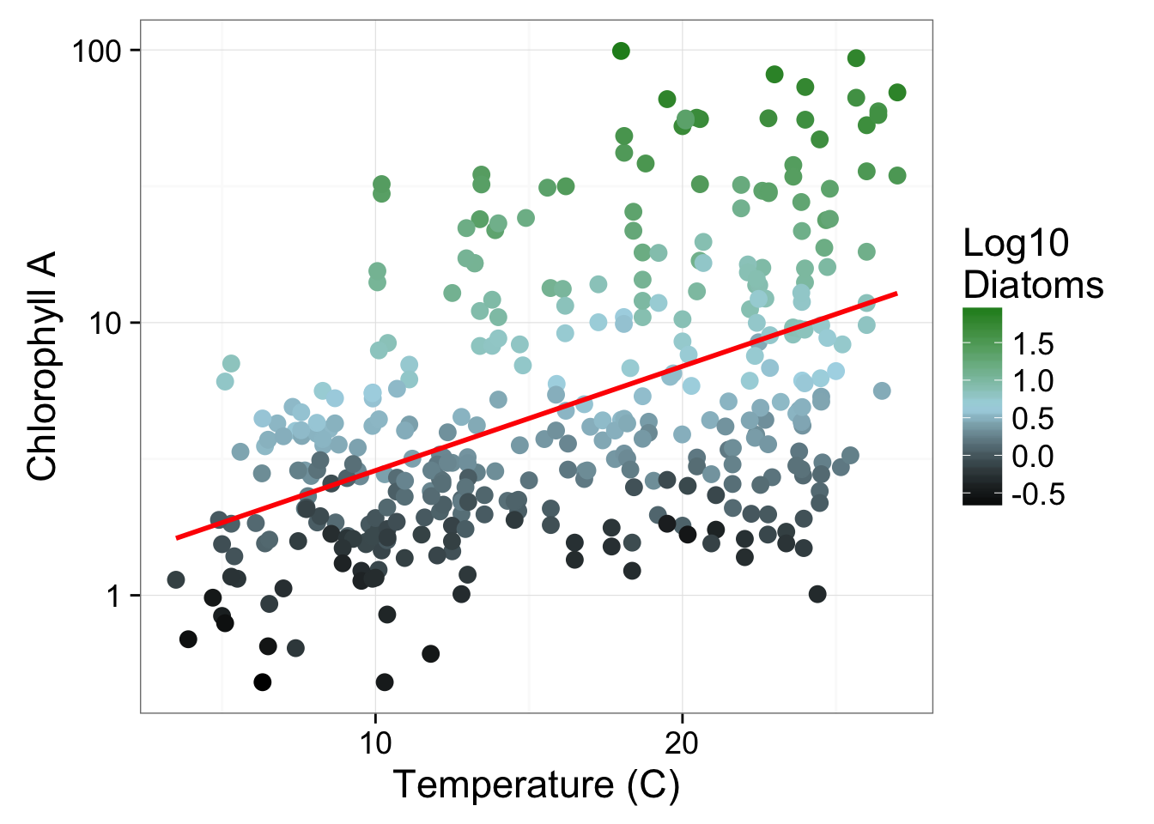

Slide 45
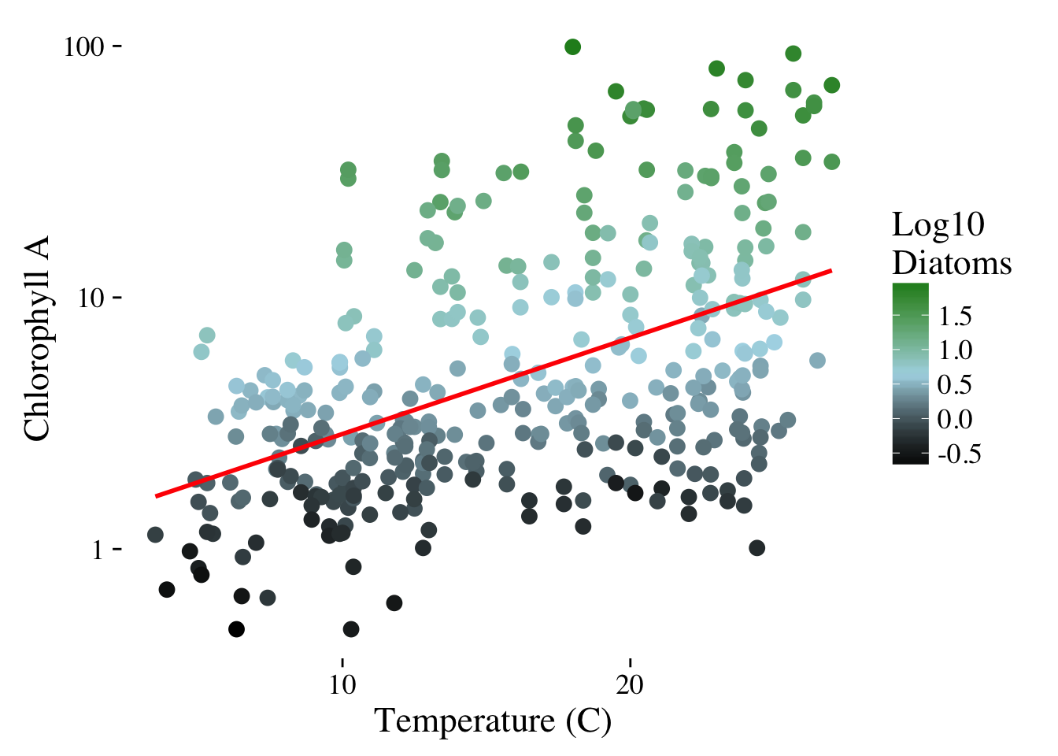

Slide 46
